Slide 1

Cosmic Microwave Background
&
Primordial Gravitational Waves
Jun-Qing Xia
Key Laboratory of Particle Astrophysics, IHEP
Planck Member
CHEP, PKU, April 3, 2014

Slide 2
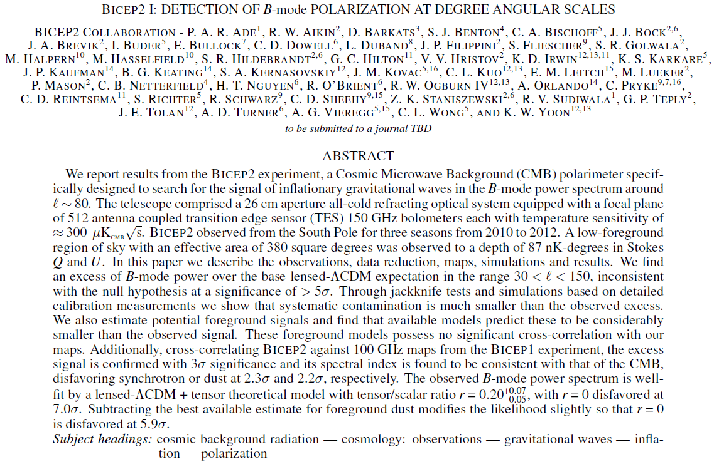
BICEP2 Paper (arXiv:1403.3985)

Slide 3


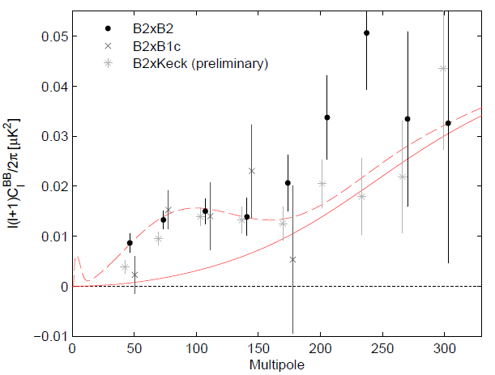
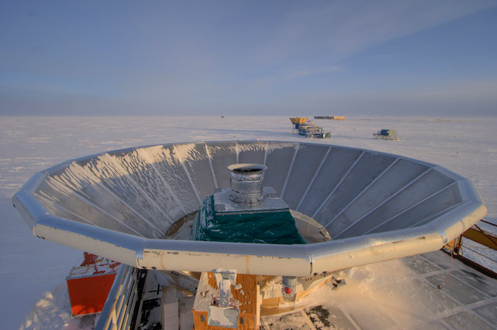
Tensor Modes Detection by BICEP2
(Ade et al., 1403.3985)
Few days ago, BICEP2 collaboration claimed that they have detected the CMB B-modes at the level of
from the primordial gravitational waves in the early universe, disfavoring the null hypothesis (r = 0) at the level of 7 sigma (5.9 sigma after foreground subtraction).

Slide 4
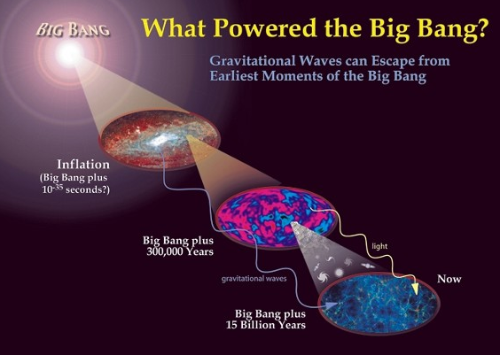
Outline
Introduction on CMB Polarization
CMB History and Current Status
B-modes Detection by BICEP2
Discussions

Slide 5
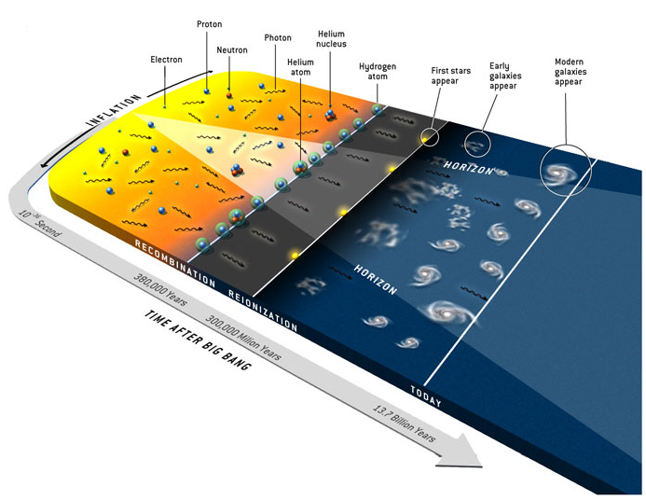
Cosmic Microwave Background

Slide 6
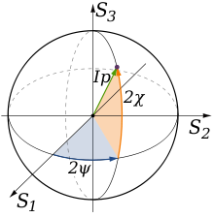
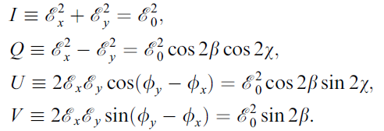
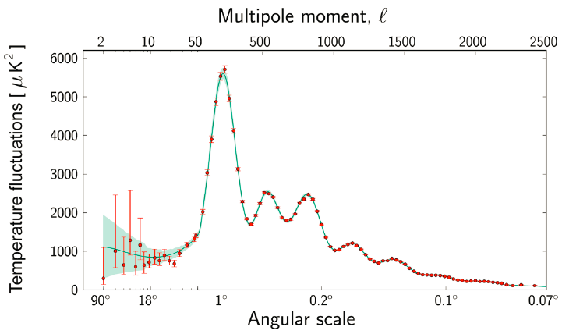
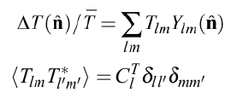
CMB Temperature Fluctuations
Consider as a plane electromagnetic wave, CMB photon information are described by the Stokes parameters:
CMB TT Power Spectrum:
(Planck 2013 results, 1303.5062)

Slide 7
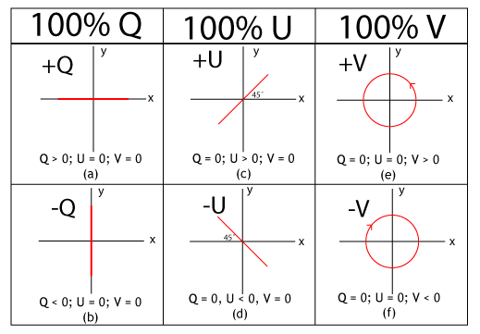
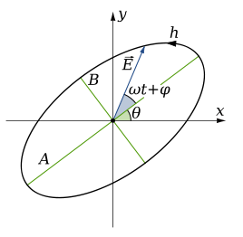


CMB Polarization
CMB极化信息：
E/B decomposition:

Slide 8
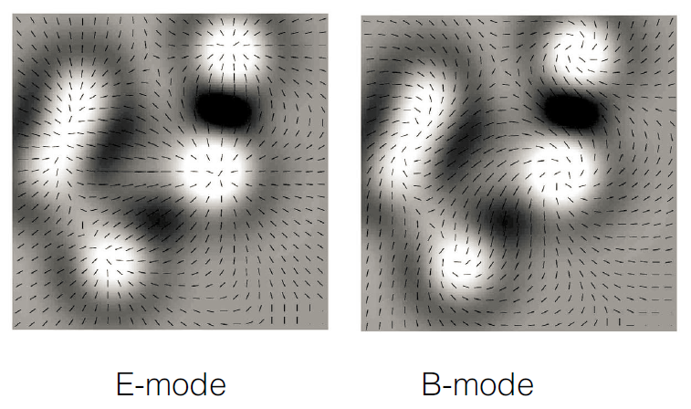
CMB Polarization Modes
(Durrer, 2008)

Slide 9
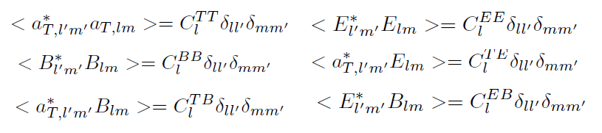
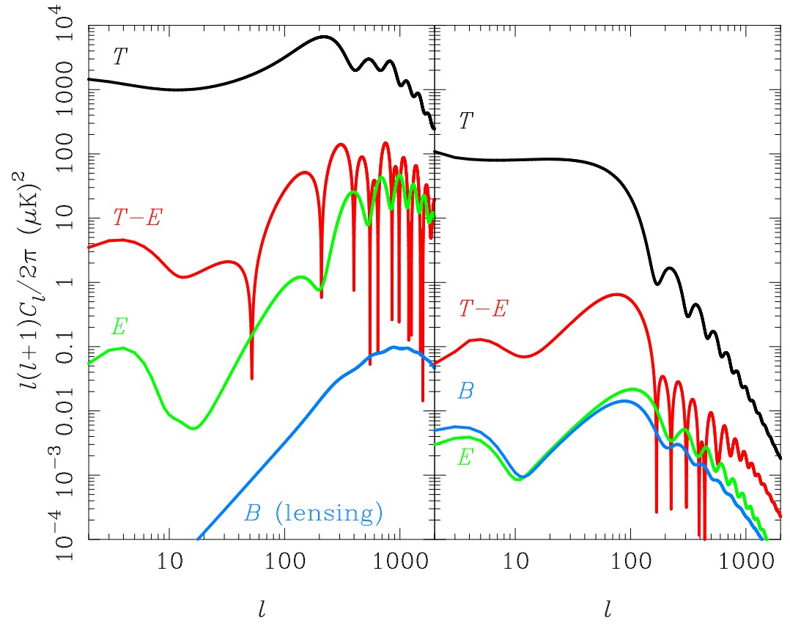
CMB Power Spectra
(Challinor & Peiris, 2009)

Slide 10
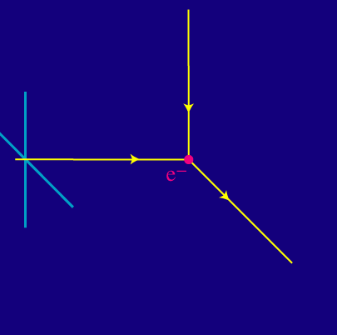
How generate CMB polarization?
(Wayne Hu, CMB Tutorials)

Slide 11
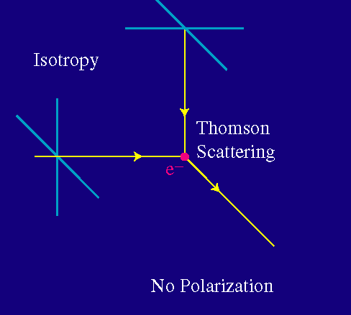
How generate CMB polarization?
(Wayne Hu, CMB Tutorials)

Slide 12
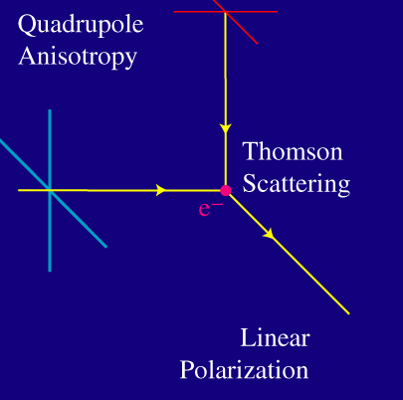
How generate CMB polarization?
(Wayne Hu, CMB Tutorials)
Only if the intensity of the CMB radiation varies at 90 degrees, i.e. the distribution has a quadrupole pattern, does a net linear polarization result.

Slide 13
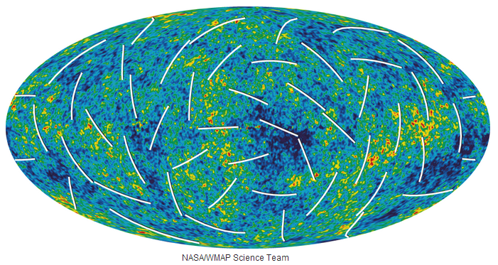
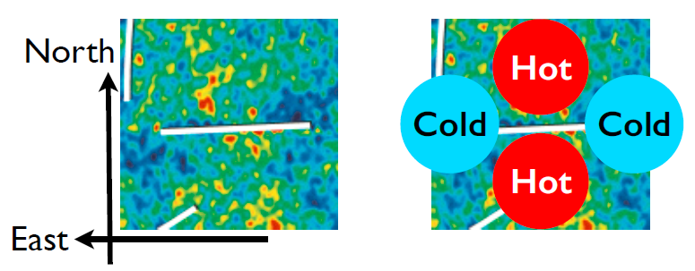
WMAP Polarization

Slide 14
Origin of Quadrupole
Two sources to generate CMB power spectra:
Scalar perturbations (density perturbations): T & E
Tensor perturbations (primordial gravitational waves): T, E & B
If the primordial B-mode polarization detected, verify primordial gravitational waves and Inflation.

Slide 15
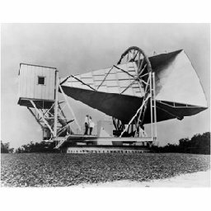
CMB History and Current Status

Slide 16

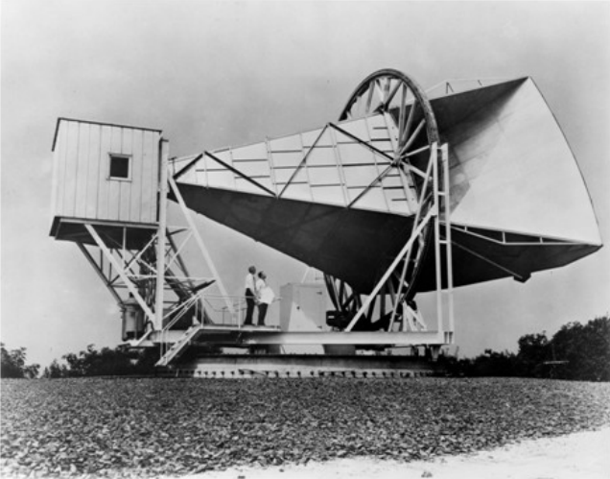
CMB Detected
The cosmic microwave background was first detected in 1964 by Arno Penzias and Robert Woodrow Wilson who received the 1978 Nobel Prize in Physics.

Slide 17
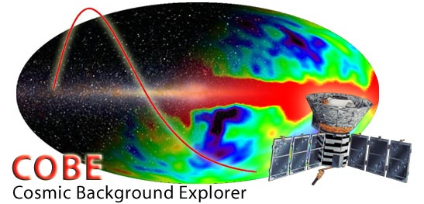
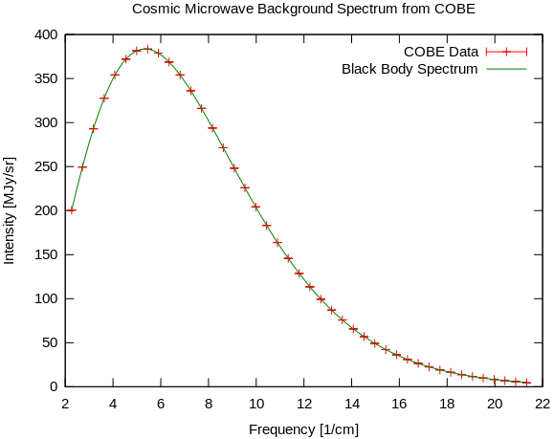
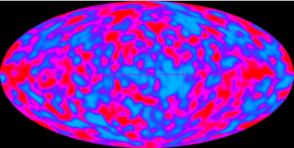
CMB Temperature Anisotropy
The CMB temperature anisotropy and the black body form of the CMB spectrum was first detected in 1989-1992 by the COBE satellite. George Smoot & John Mather received the 2006 Nobel Prize in Physics.

Slide 18
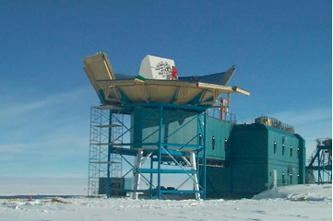
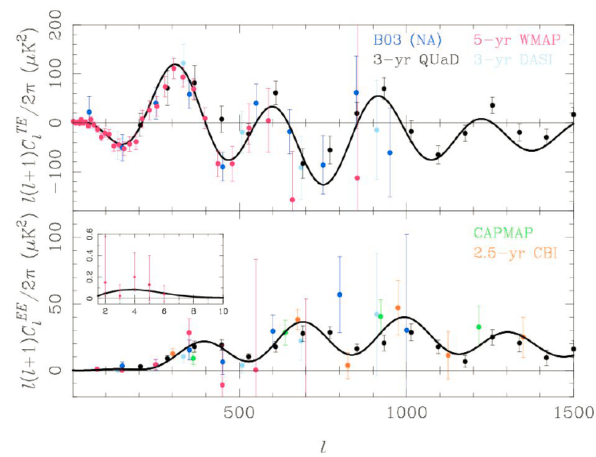
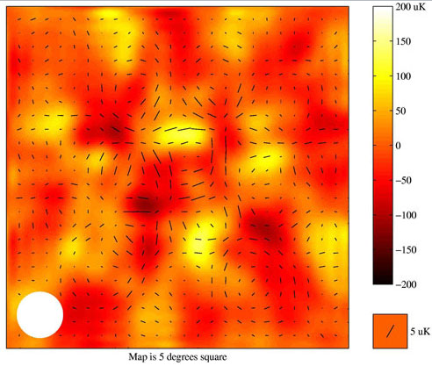
CMB Polarization
(Leitch et al. 2002)
The CMB polarization E-modes was first detected in 2002 by the DASI experiment.

Slide 19
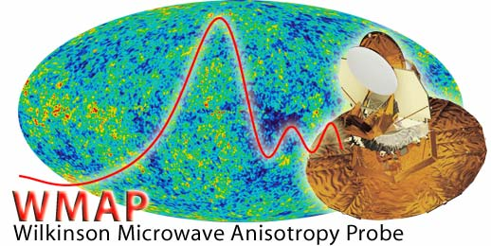

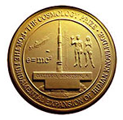
Precision Cosmology
Wilkinson Microwave Anisotropy Probe (WMAP) is one of the most important and successful CMB experiments.
Played the key role in establishing the Standard LCDM model, determined several cosmological parameters accurately, like Age of Universe, fraction of matter and dark energy density, the Hubble constant, improved our understanding on Cosmology.
Received the 2010 Shaw Prize in Astronomy and the 2012 Gruber Prize in Cosmology.

Slide 20
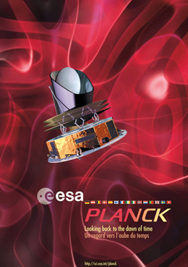
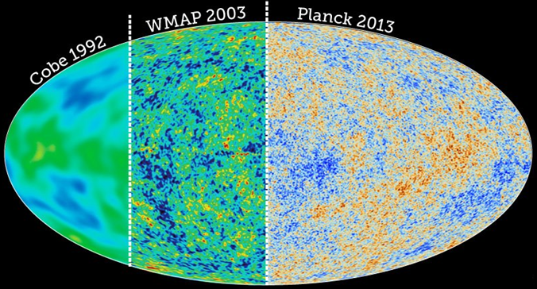
Planck Experiment
(Planck 2013 results, 1303.5062)
ESA’s Planck was formerly called COBRAS /SAMBA. It is designed to image the anisotropies of the CMB over the whole sky, with unprecedented sensitivity and angular resolution.

Slide 21
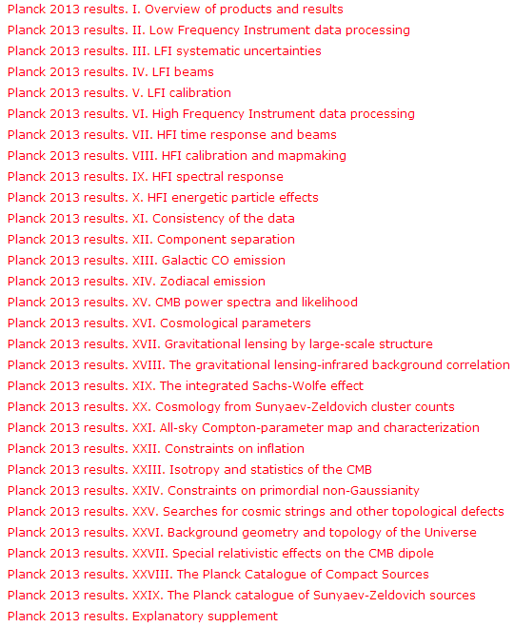
Planck 2013 results
The scientific findings of the mission are presented in 29 papers based on data from the first 15.5 months of Planck operations.
I am the Core Team Member of LFI and involved in papers:
  XII. Component separation (1303.5072)
  XIX. The integrated Sachs-Wolfe effect (1303.5079)

Slide 22
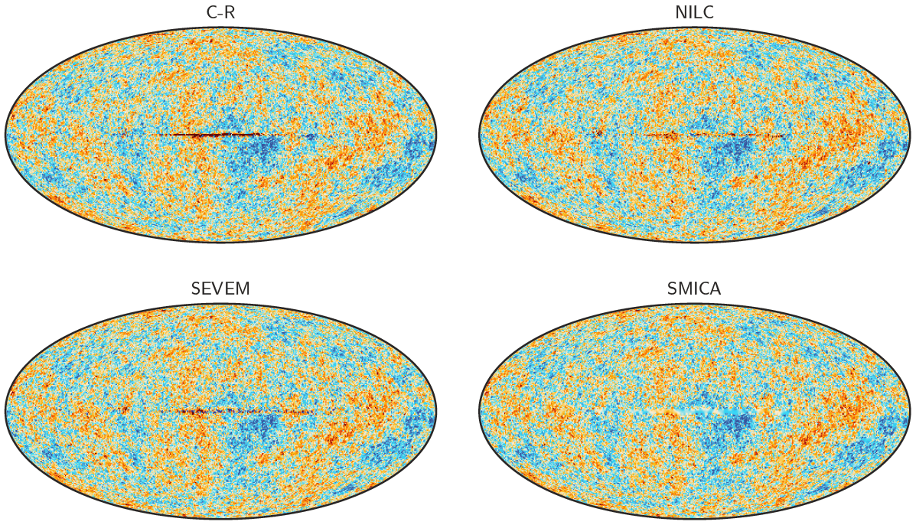
Foreground-cleaned CMB Maps
For scientific goals, Planck provides four foreground-cleaned CMB maps derived using qualitatively different component separation algorithms.

Slide 23
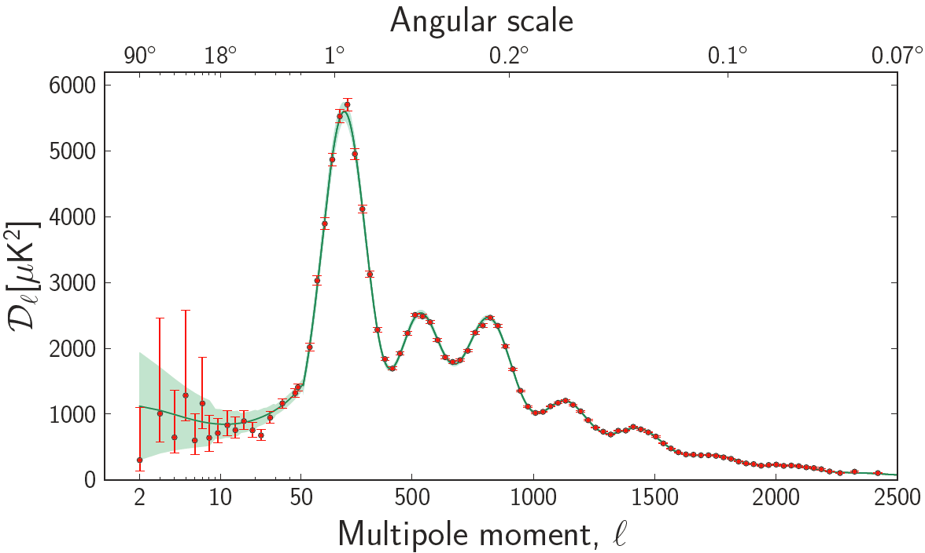
Temperature Power Spectrum
(Planck 2013 results, 1303.5062)

Slide 24
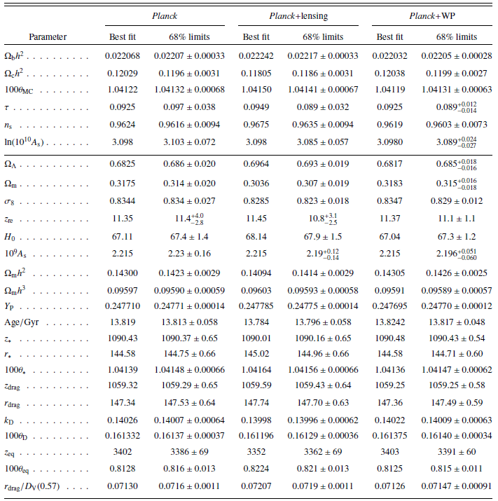
Constraints on LCDM
(Planck 2013 results, 1303.5076)

Slide 25
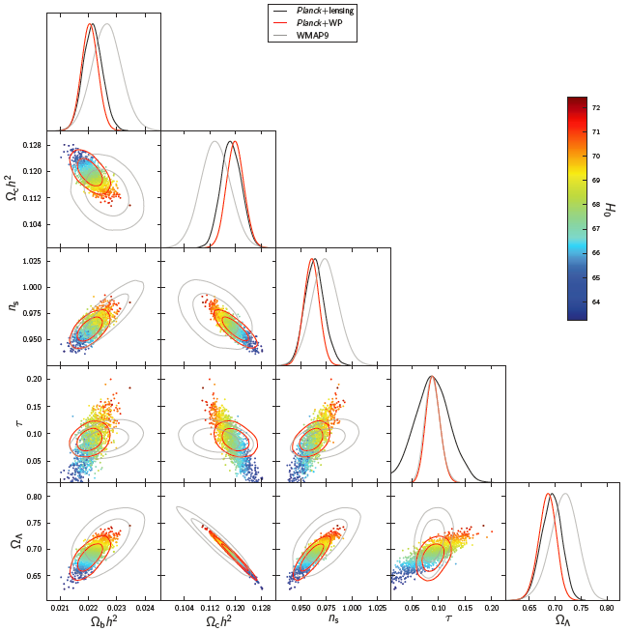
Comparison with WMAP9
(Planck 2013 results, 1303.5076)

Slide 26
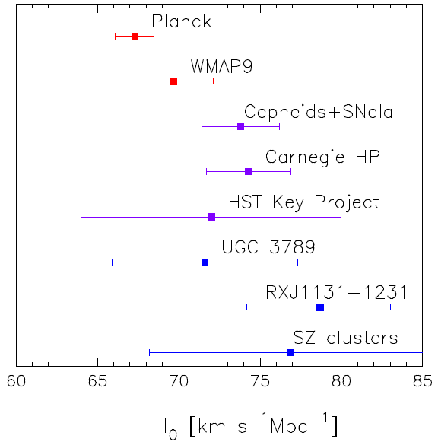
Hubble Constant
(Planck 2013 results, 1303.5076)
In LCDM, the Planck data favor a lower value of H₀
Apparently lower than that directly measured by some experiments, like HST
(Riess et al.,2011)

Slide 27
Hubble Constant
(Planck 2013 results, 1303.5076)
In LCDM, the Planck data favor a lower value of H₀
Apparently lower than that directly measured by some experiments, like HST
(Riess et al.,2011)

Slide 28
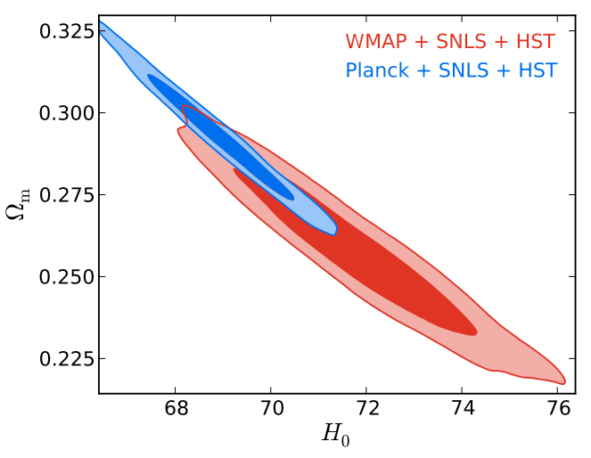
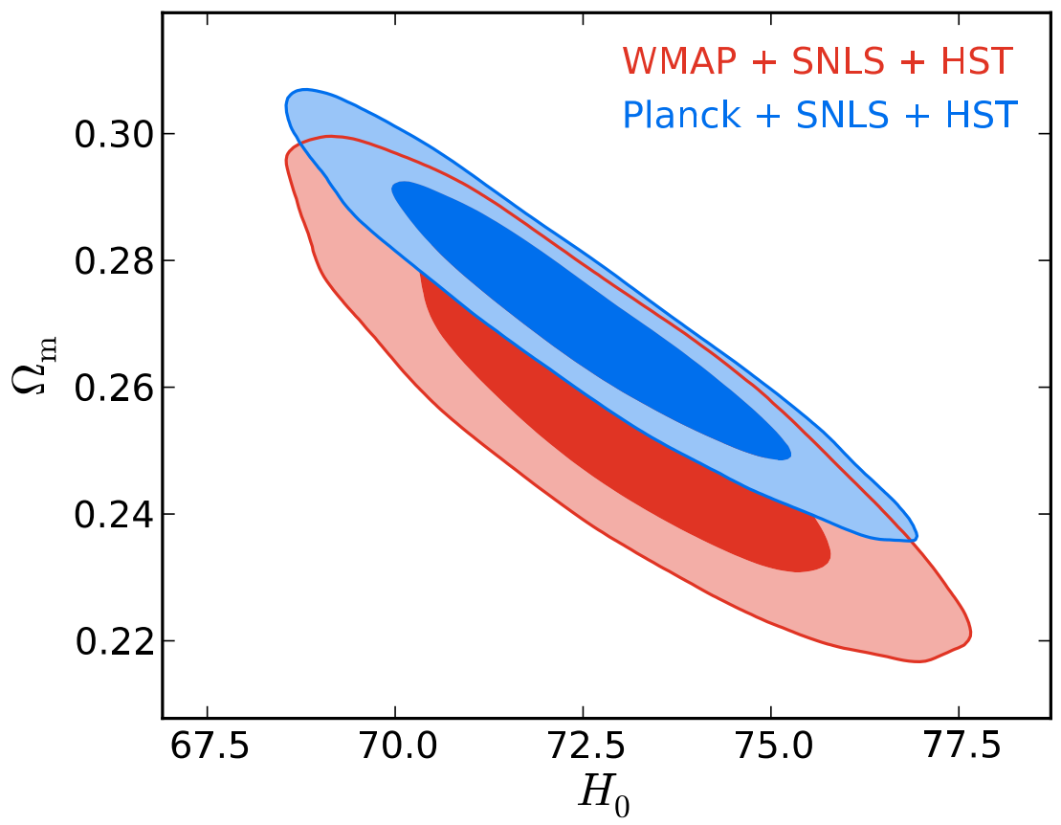

Dynamical Dark Energy
(Xia, Li, Zhang, 2013)
Realized this tension may imply that the standard LCDM model can not explain the Planck data very well. The dynamical dark energy is needed.
LCDM
wCDM

Slide 29
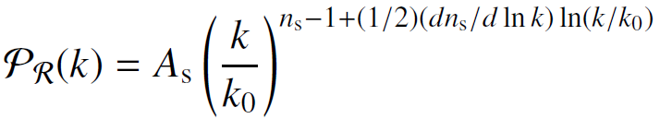
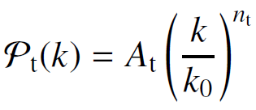

Inflationary Parameters
The curvature power spectrum parameterized by:
The tensor mode spectrum is parameterized by:

Slide 30


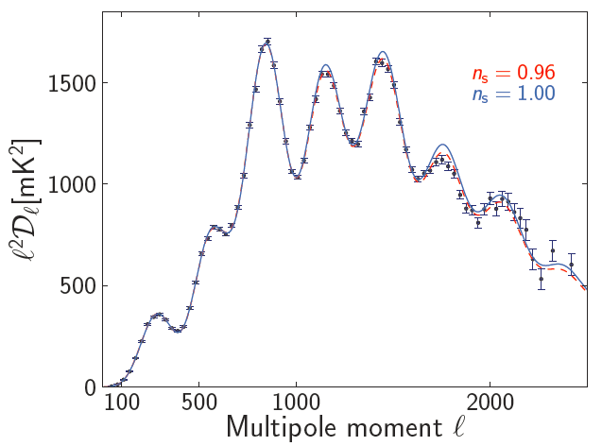
Spectral Index n_{s}
(Planck 2013 results, 1303.5076)
Planck data still disfavor the HZ spectrum (n_{s}=1) at about 8σ C.L. in the LCDM framework.

Slide 31


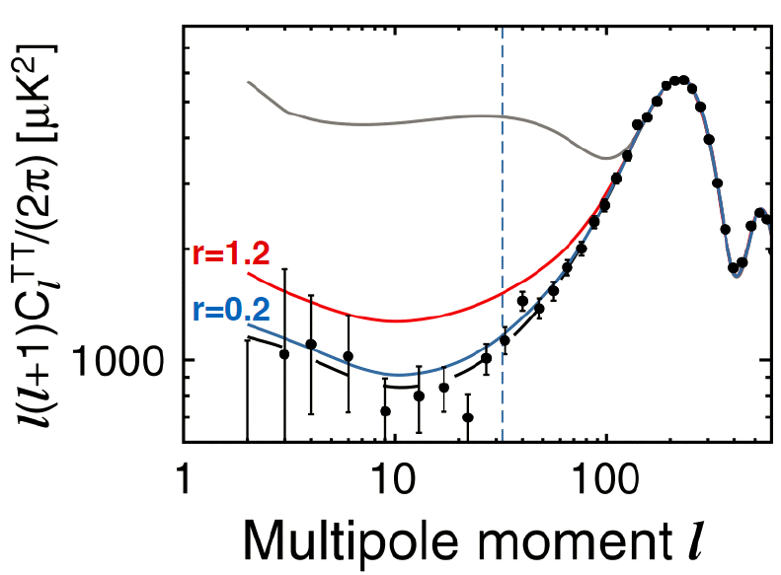
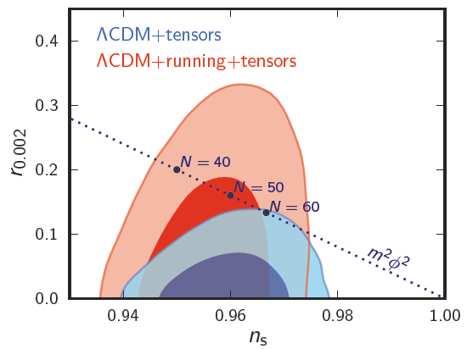
Tensor Mode
(Planck 2013 results, 1303.5082)
Measurements of the temperature power spectrum can also be used to constrain the amplitude of tensor modes, the ratio of tensor primordial power to curvature power.

Slide 32
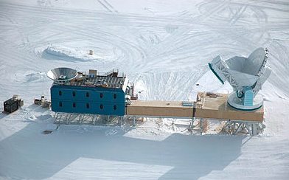
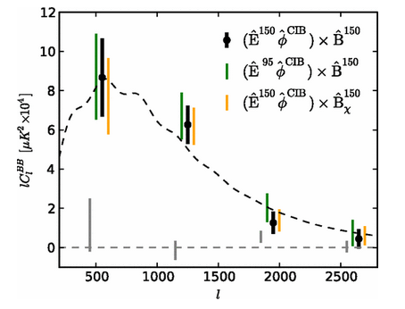
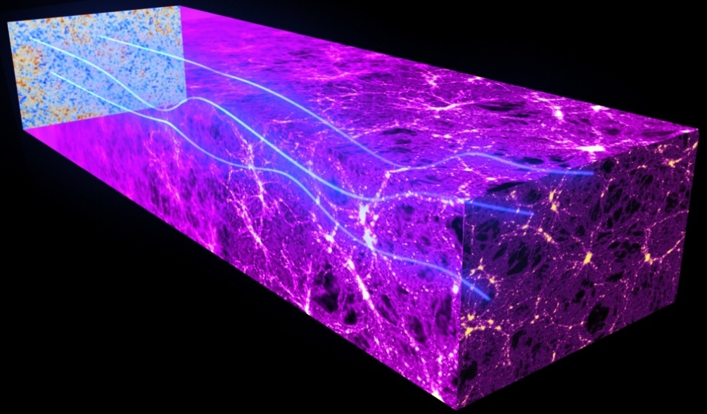
CMB Lensing Effect
(Hanson et al. 2013)
The South Pole Telescope (SPT) Experiment, starting the CMB polarization detection since 2013, reported a 7.7 sigma detection the B-modes from the Lensing effect.
Confirmed by another CMB experiment, PolarBear in Chile.

Slide 33
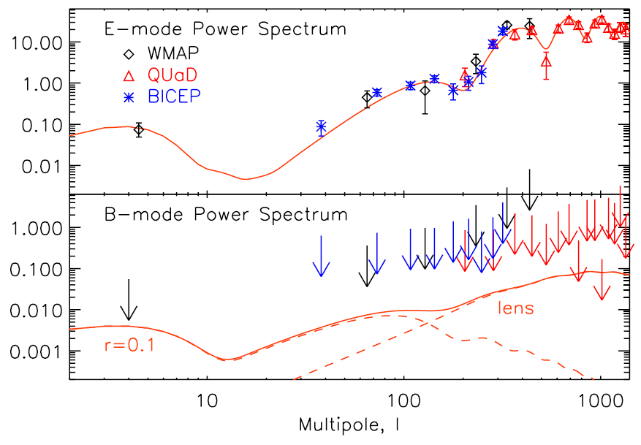
No B-modes Detection, before 2014.3.17

Slide 34
Measurement CMB B-modes and Detection Primordial Gravitational Waves by BICEP2

Slide 35

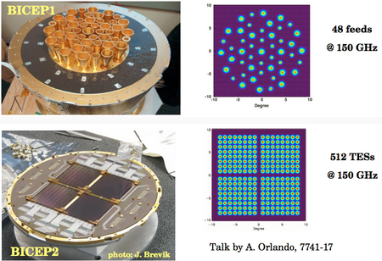
BICEP Experiment
(Ade et al., 1403.4302)
Background Imaging of Cosmic Extragalactic Polarization (BICEP), located at Amudsen-Scott South Pole Station.
During 2006 – 2008, the first BICEP instrument observed the sky at 100 and 150 GHz with an angular resolution of 1.0 and 0.7 degrees, and gave constraint on the tensor-to-scalar ratio:
In 2010-2012,BICEP2 used a greatly improved focal plane transition edge sensor (TES) bolometer array of 512 sensors (256 pixels) operating at 150GHz.

Slide 36
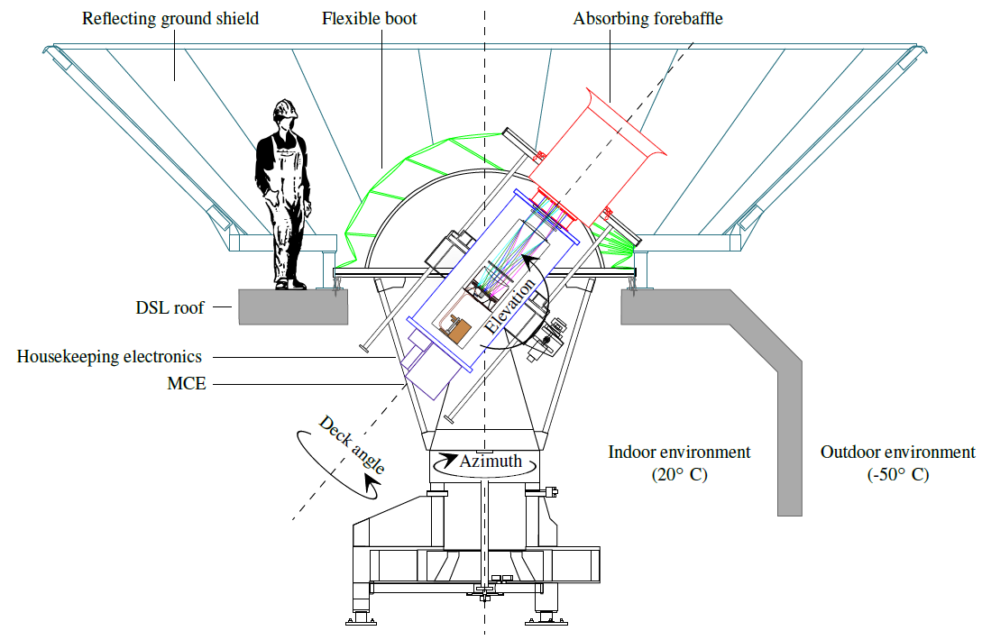
BICEP2 Telescope
(Ade et al., 1403.4302)

Slide 37

BICEP2 Survey Area
(Ade et al., 1403.4302)
BICEP2 mainly observe the CMB field “Southern Hole”, where polarized foregrounds are expected to be especially low (~380deg²).
centered at (RA = 0 hr, dec = -57.5 deg).

Slide 38

Detect excess B-modes
(Ade et al., 1403.3985)

Slide 39
Detect excess B-modes
(Ade et al., 1403.3985)

Slide 40

CMB Temperature & Polarization Spectra

Slide 41

Constraint
(Ade et al., 1403.3985)
Detect CMB Primordial B-modes spectrum and constraint the tensor-to-scalar ratio
detect the primordial gravitational waves at 7 sigma confidence level.

Slide 42



Systematic & Foreground
(Ade et al., 1403.3985)
5.9sigma
r > 0

Slide 43


Some Discussions

Slide 44






Worries
Using the B1(100)xB2(150) GHz cross, they are able to “reject” representative spectra of synchrotron and dust at ~2 sigma level.
In other words, it is only ~2 sigma level that they can claim the cosmological origin of the signal.

Slide 45

Worries

Slide 46


Worries

Slide 47

Consistent with Planck results?
(Li, Xia & Zhang, 1404.0238)
VS

Slide 48

Including extra parameters
(Ade et al., 1403.3985)
In order to lessen the tension between BICEP2 and Planck results, one could include extra cosmological parameters, like the running of scalar spectrum index, to relax the constraint on r from Planck data.

Slide 49


Cut off at large scales
(Xia, Cai, Li Zhang, 1403.7623)
The large value of r from BICEP2 will bring the extra power on CMB TT power spectrum, which leads to the worse fit to the Planck data.
The theoretical model with a cut off at large scales is more favored by the data.

Slide 50



Rotation Angle
(Xia, Li & Zhang, 2010)
Using BICEP1 polarization data, in 2010 we find that this data supported a non-zero rotation angle, which implies the CPT symmetry might be violated.
(Feng, Li, Xia, Chen & Zhang, 2006)

Slide 51


Self-calibration
(Ade et al., 1403.3985)
Inspired by our work, the BICEP collaboration improved the calibration method. They used the obtained TB and EB spectra, which should vanish in standard CMB theory, to calibrate the BICEP observations, including the BB power spectrum.

Slide 52

Rotation Angle?
(Li, Xia & Zhang, 1404.0238)
The non-zero rotation angle with few degrees could give similar order of CMB BB spectrum, but the shape can not match.

Slide 53

Future CMB Measurements
Verify the BICEP2 result
Constraint the tensor spectrum index, nt
Detect primordial B-modes at l < 10
Operating | Plan | Future
Planck(极化结果) | EBEx-6K | COrE
EBEx(气球) | PolarBear-2 | PRISM
PolarBear-1(智利) | SPTpol-3G | PIXIE
SPTpol(南极) | BICEP-2,3 | EPIC
ACTpol(智利) | LiteBIRD(日本) | ……
…… | QUBIC
 | ……

Slide 54

Summary
We need more experiments to verify this amazing result, like the Planck polarization in this october.
Thanks!!

