Slide 1



Majorana Neutrinos
&
Recent CUORE Result on Neutrinoless Double Beta Decay
Huan Zhong Huang (黄焕中)
Department of Physics and Astronomy
University of California, Los Angeles 90095
huang@physics.ucla.edu
Institute of Modern Physics (现代物理研究所)
Fudan University (复旦大学)

Slide 2
Outline
Introduction to Neutrino Properties
Majorana Neutrinos and
Neutrinoless Double Beta Decay (0vbb)
CUORE (Cryogenic Underground Observatory
  for Rate Events) Results
4) Outlook

Slide 3
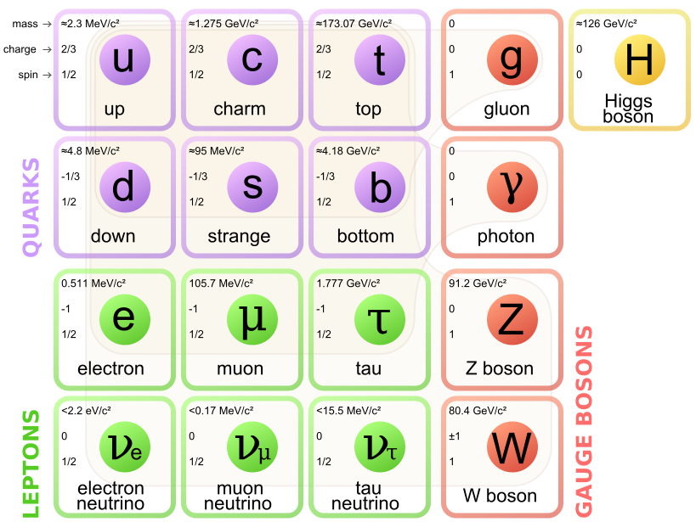
Leptons and Flavor
Neutrino – Nobel Prize
-- 1995 Reines ν_{e} (1953);
Perl τ →ν_{τ} (1977)
-- 1988 Lederman,
Schwartz, Steinberger ν_{μ} (1962)
-- 2002 Davis and Koshiba
cosmic ν
-- 2015 Kajita and McDonald
ν oscillations

Slide 4
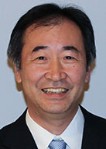
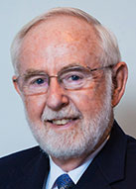
Nobel Prize in Physics 2015
Takaaki Kajita
Arthur B. McDonald
“For the discovery of neutrino oscillations, which shows
that neutrinos have mass”

Slide 5
2016 Breakthrough Prize in Fundamental Physics
Kam-Biu Luk, Yifang Wang, and the Daya Bay Collaboration
Koichiro Nishikawa and the K2K and T2K Collaboration
Atsuto Suzuki and the KamLAND Collaboration
Arthur B. McDonald and the SNO Collaboration
Takaaki Kajita, Yoichiro Suzuki and the SuperK Collaboration
For the fundamental discovery and exploration of neutrino
oscillations, revealing a new frontier beyond, and possibly
far beyond, the standard model of particle physics.
Neutrino oscillation ← flavor states are not the mass eigenstates !

Slide 6
Neutrino Mixing
Pontecorvo-Maki-Nakagawa-Sakata Matrix
Parametrize the PMNS matrix as:
Solar, reactor
reactor and accelerator
Atmospheric, accelerator
0νββ
θ₁₂ = ~ 32°
θ₁₃ = 8.5º
θ₂₃ ~ 45°
δ CP violation in lepton sector ?!

Slide 7
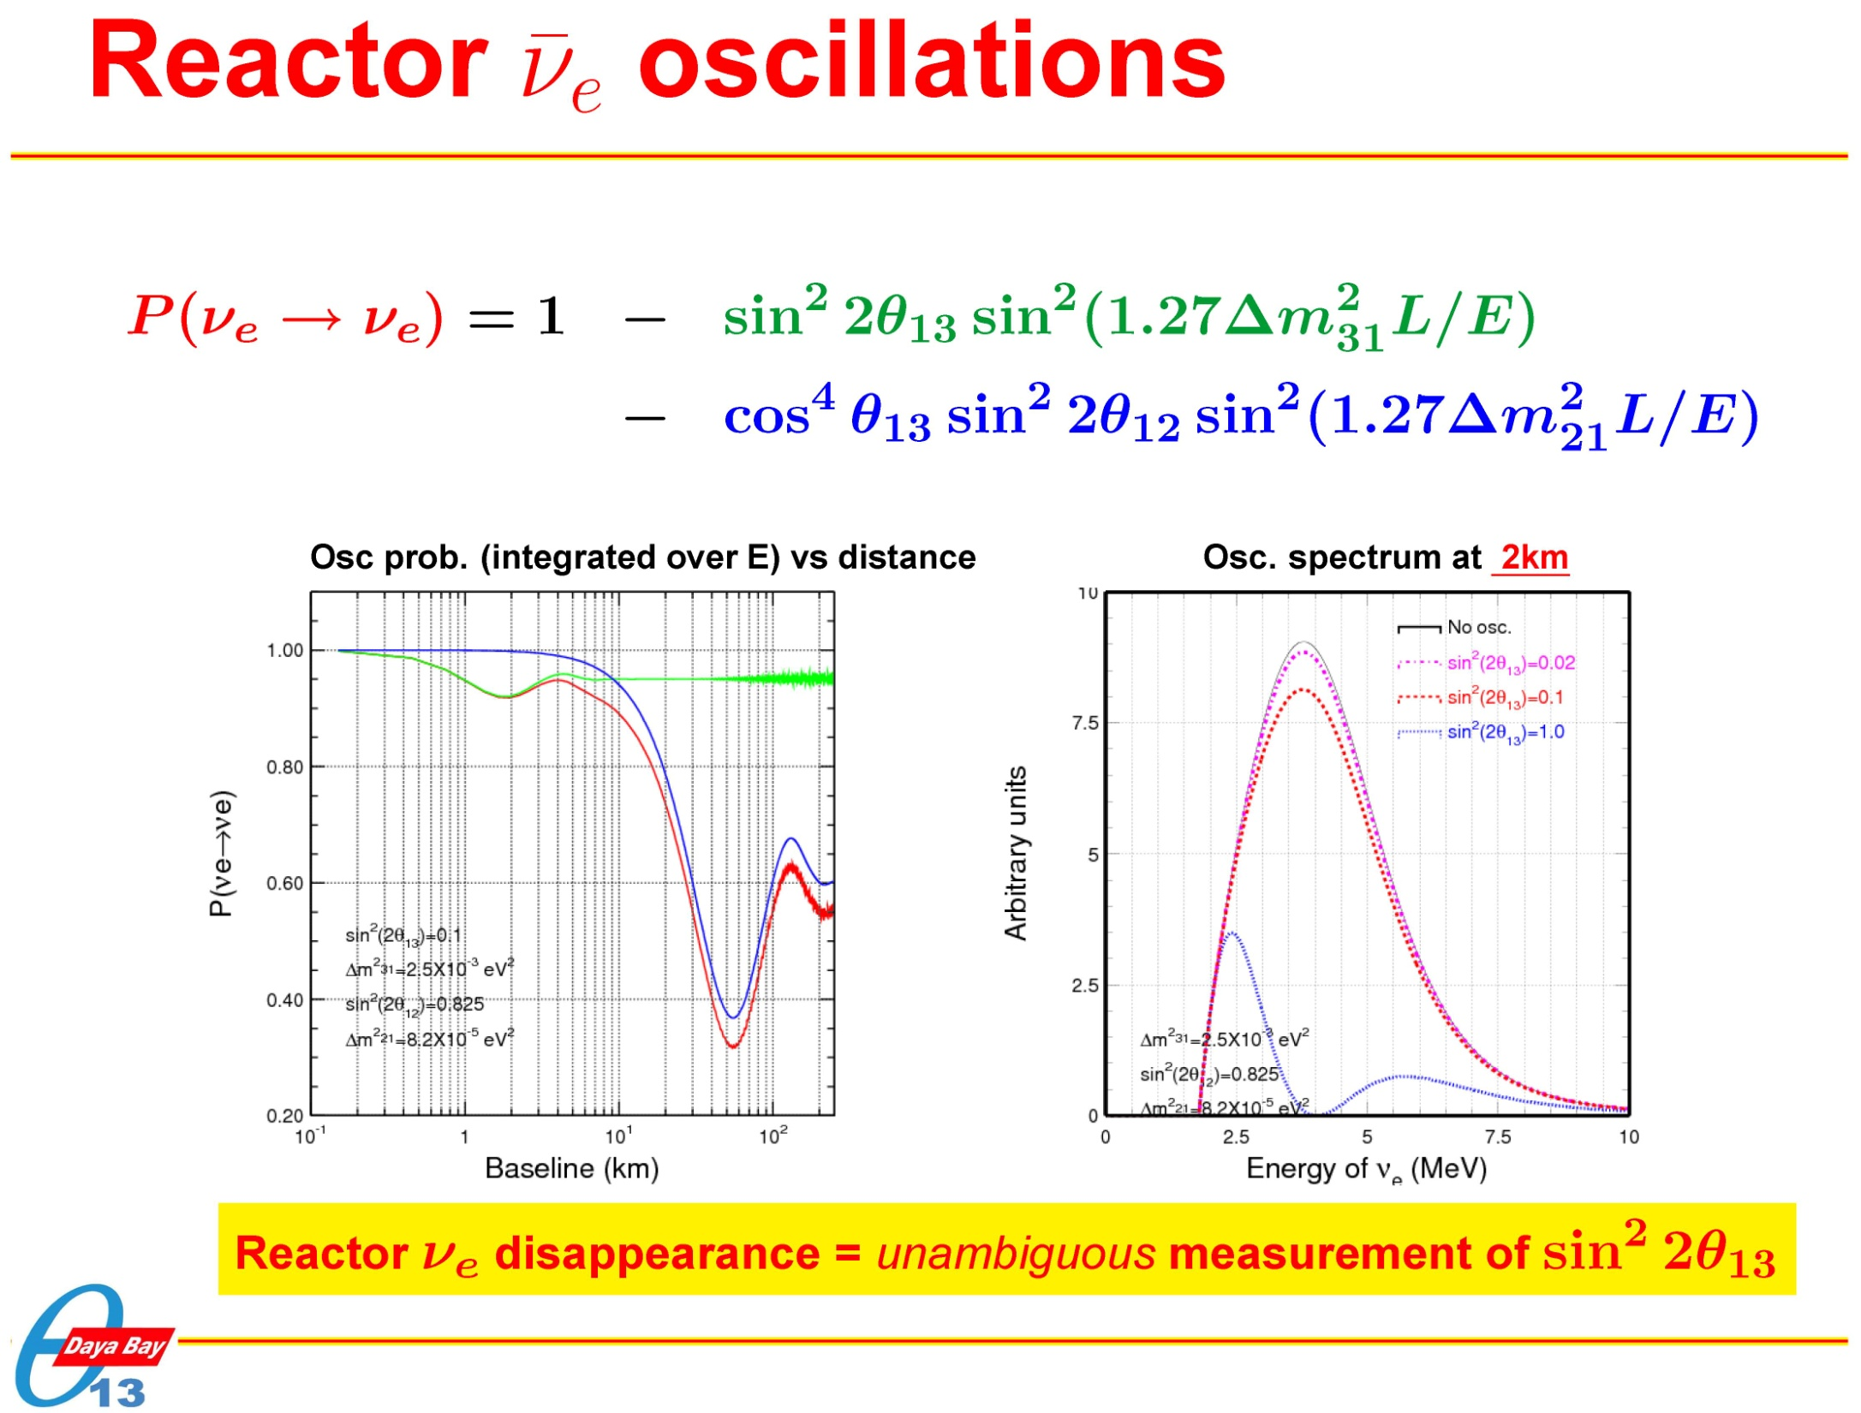

Slide 8
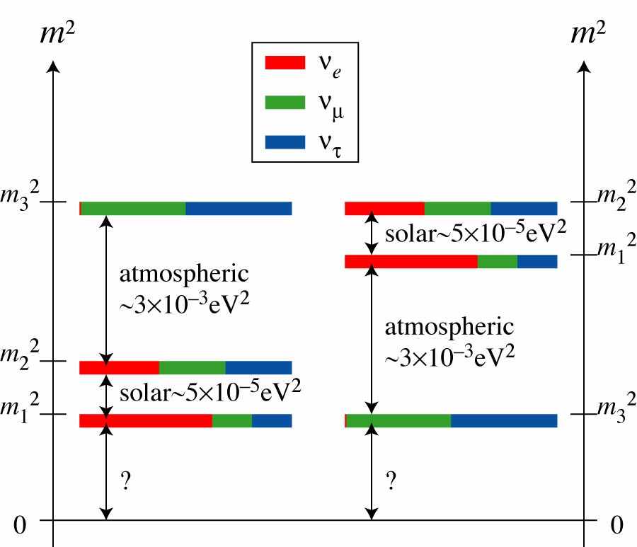
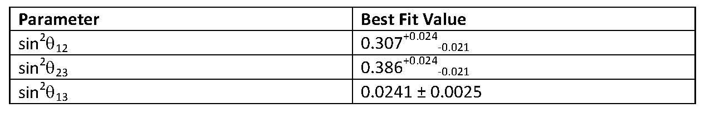
Neutrino Mass and Mixing Parameters

Slide 9
Dirac or Majorana Particles
Dirac Particles ➔ particle and anti-particle different
-- electron (q=-1) and positron (q = +1)
-- quarks (q) and anti-quarks (-q)
Majorana Particles ➔ particle and anti-particle same
-- neutral particle, fermion
-- beyond Standard Model (lepton # violation)

Slide 10
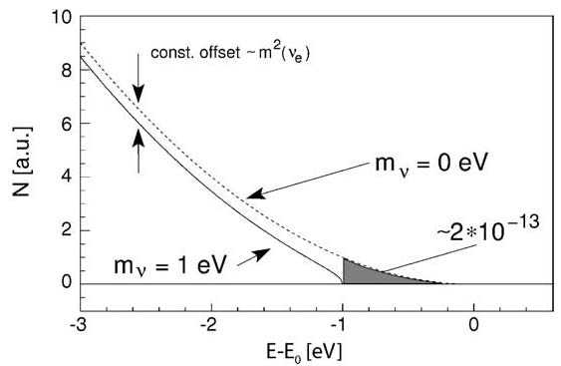
Measuring Neutrino Masses
Direct Measurement
tritium decays
E₀ = 18.6 keV
<m_{β}> =
2) Effective Majorana Mass
<m_{ββ}> =
ε_{i} – CP phase for neutrinos
3) Precise Cosmological Measurement
<m_{Σ}> =

Slide 11
Neutrino Physics Program
Critical Questions for Future Neutrino Physics Program
1) Are neutrinos their own anti-particles?
Dirac or Majorana neutrinos
Majorana – lepton violation, masses
2) What are the scale of neutrino masses and the
hierarchy of the neutrino mass ordering?
3) Do neutrinos violate the CP symmetry and
contribute to the matter-antimatter
asymmetry?
4) Are there sterile neutrinos?

Slide 12
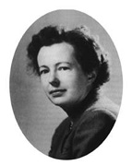
Double Beta Decay
(A,Z+1)
2νββ
Even-even nucleus
(A,Z)
ββ
(A,Z+2)
2νββ: T_{1/2} ≥ 10¹⁸y
(A,Z)
W
1935
e–
M. Goeppert-Mayer
e–
W
(A,Z+2)
(A,Z) → (A,Z+2) + 2e– + 2‾ν_{e}

Slide 13
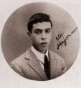
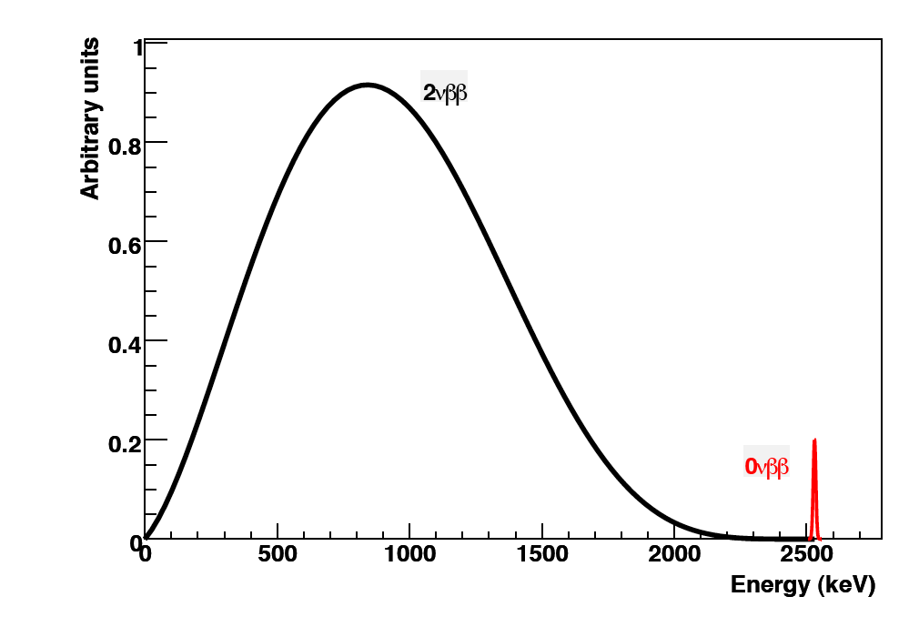
Majorana Neutrinos?
0νββ
1937
0νββ: T_{1/2} ≥ 10²⁵y
(A,Z)
W
e–
ν
e
ν
e–
e
W
(A,Z+2)
(A,Z) → (A,Z+2) + 2e–
Majorana → neutrino = anti-neutrino
Lepton Number violation !

Slide 14
Double Beta Decay Candidates
Normal beta-decay is energetically forbidden, while
double beta-decay from (A,Z) → (A, Z+2) is energetically
allowed:
(A=even, Z=even)
A, Z+1
0⁺
A, Z+3
A, Z
ββ
0⁺
A, Z+2
Some candidates:
⁴⁸Ca, ⁷⁰Zn, ⁷⁶Ge, ⁸⁰Se, ⁸⁶Kr, ⁹⁶Zr, ¹⁰⁰Mo, ¹¹⁶Cd, ¹³⁰Te, ¹³⁶Xe, ¹⁵⁰Nd

Slide 15
Candidate for Double beta Decays
Q (MeV) Abund.(%)
⁴⁸Ca→⁴⁸Ti | 4.271 | 0.187
⁷⁶Ge →⁷⁶Se | 2.040 | 7.8
⁸²Se→⁸²Kr | 2.995 | 9.2
⁹⁶Zr→⁹⁶Mo | 3.350 | 2.8
¹⁰⁰Mo→¹⁰⁰Ru | 3.034 | 9.6
¹¹⁰Pd→¹¹⁰Cd | 2.013 | 11.8
¹¹⁶Cd→¹¹⁶Sn | 2.802 | 7.5
¹²⁴Sn→¹²⁴Te | 2.228 | 5.64
¹³⁰Te→¹³⁰Xe | 2.528 | 34.5
¹³⁶Xe→¹³⁶Ba | 2.479 | 8.9
¹⁵⁰Nd→¹⁵⁰Sm | 3.367 | 5.6

Slide 16
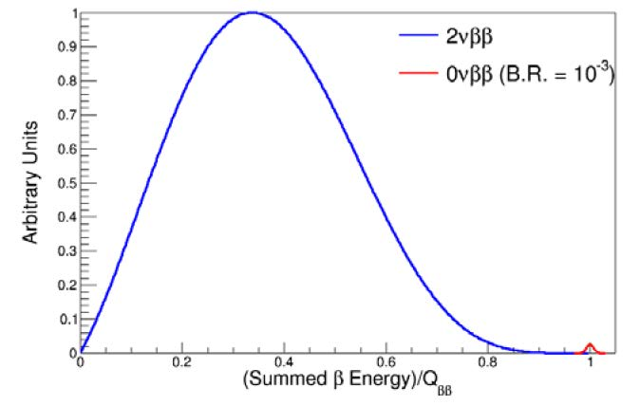
Experimental Search for 0νββ
2νββ decays are irreducible background !
We do not know the relative rate!

Slide 17
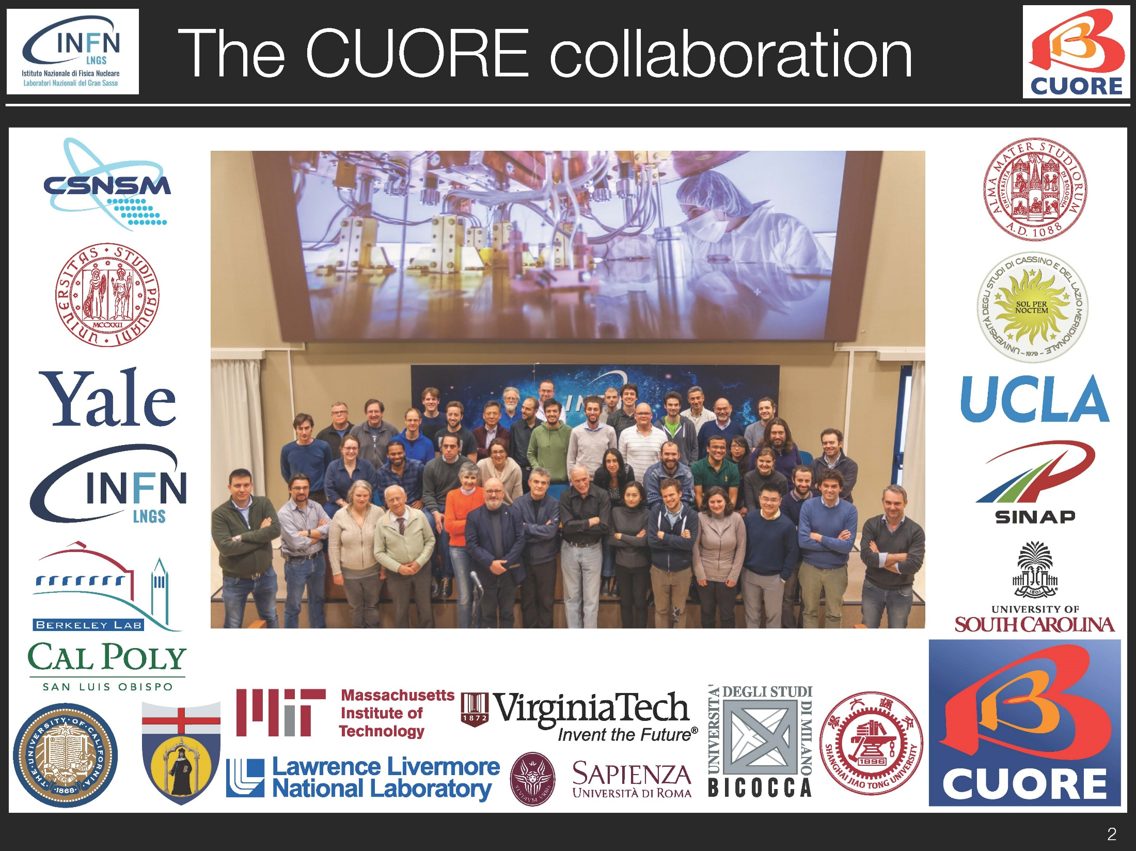

Slide 18
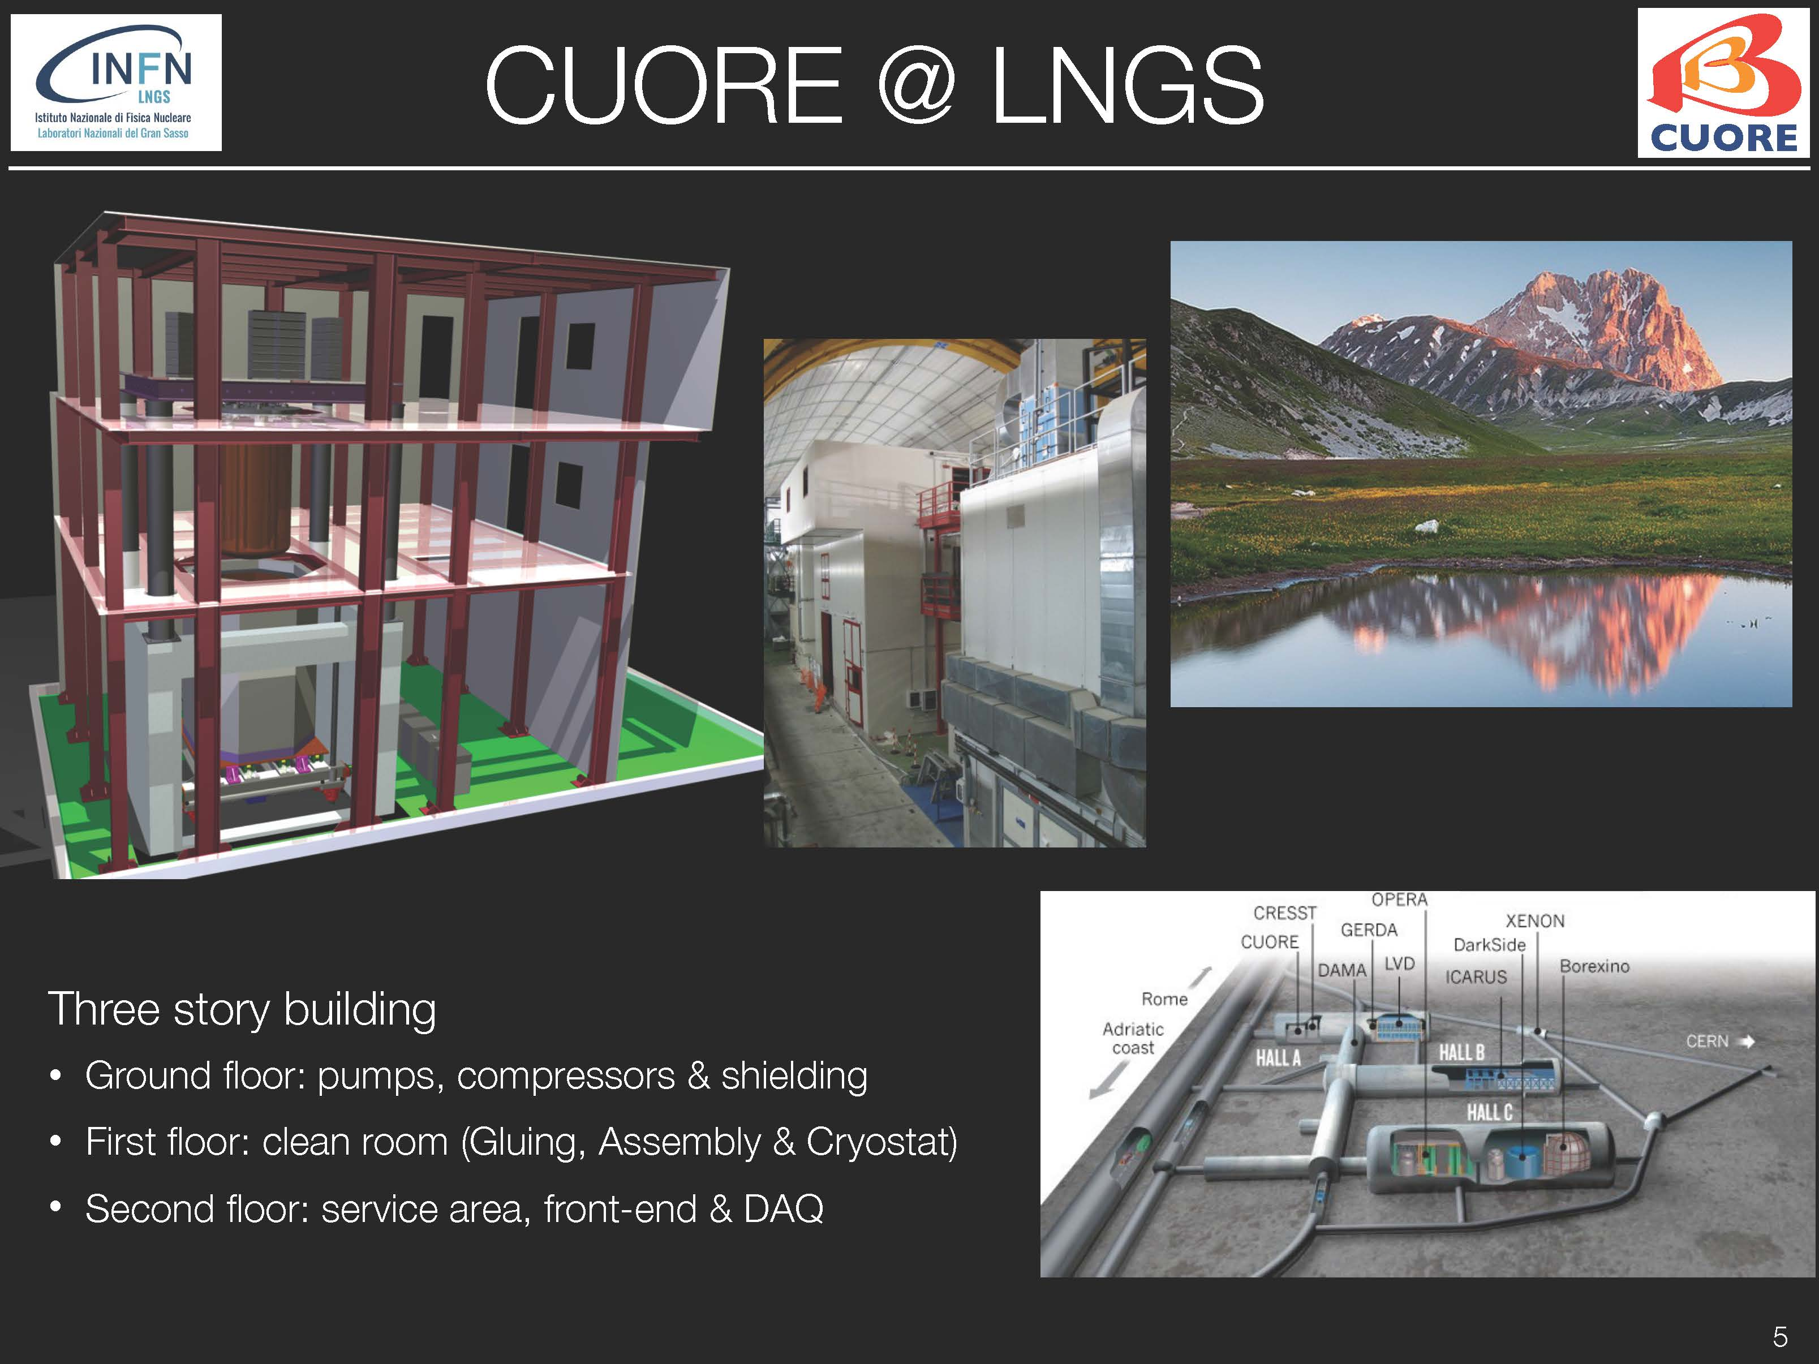

Slide 19
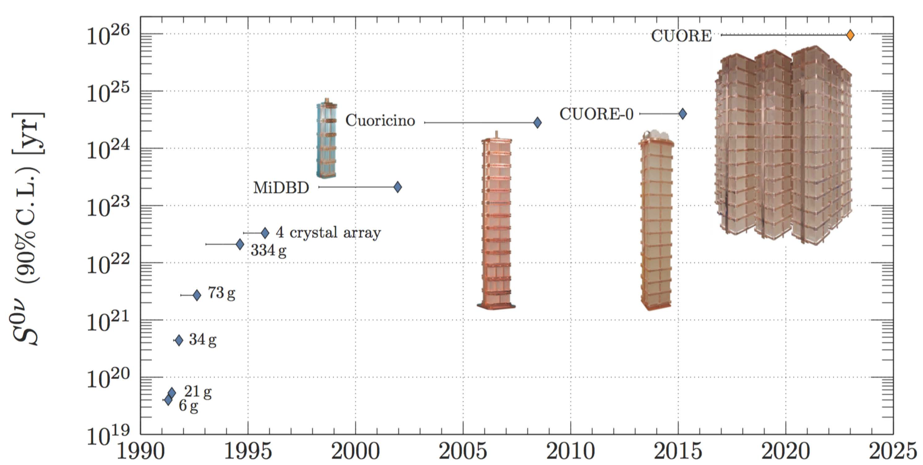
> 20 years of Detector Development

Slide 20
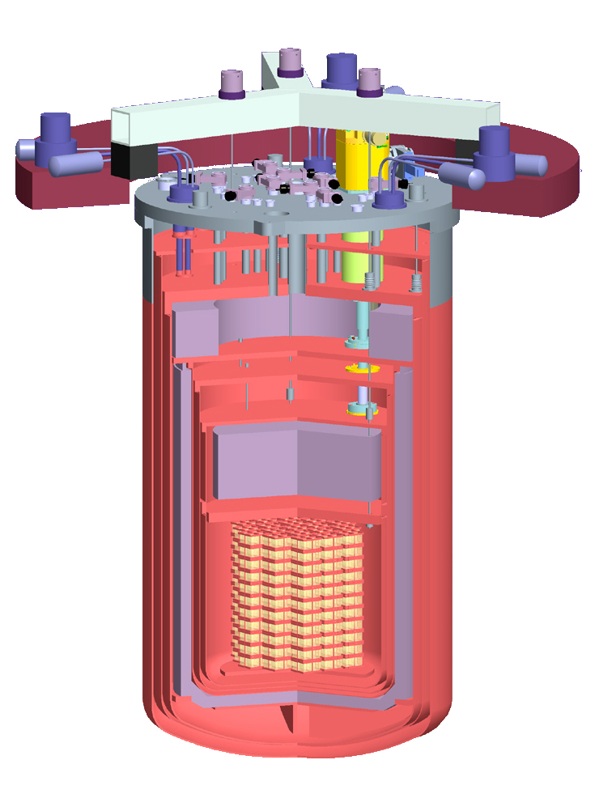
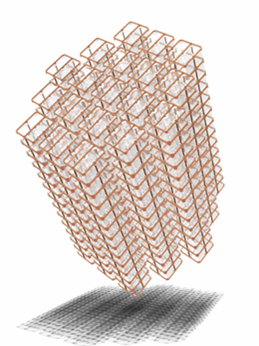
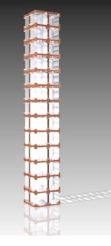

CUORE
CUORE: Cryogenic Underground Observatory for Rare Events will be a tightly packed array of 988 Bolometers - M ~ 200 kg of ¹³⁰Te
80 cm
Operated at Gran Sasso laboratory
Special cryostat built w/ selected materials
Cryogen-free dilution refrigerator
Shielded by several lead shields
19 CUORICINO-like towers with 13 planes of 4 crystals each

Slide 21
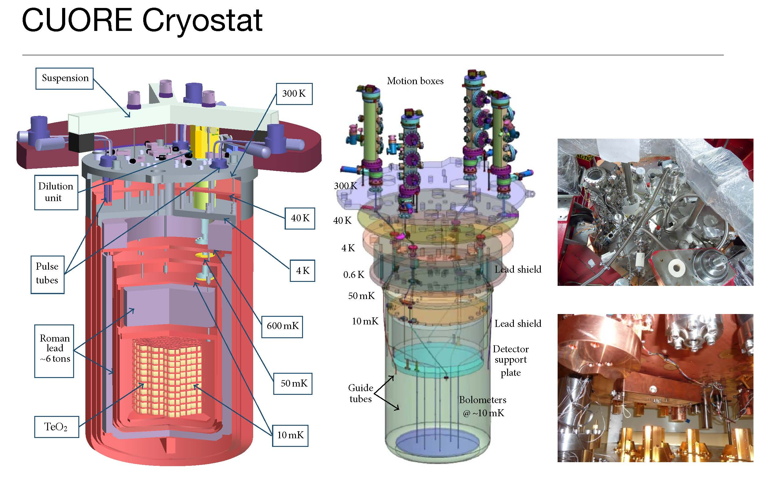

Slide 22
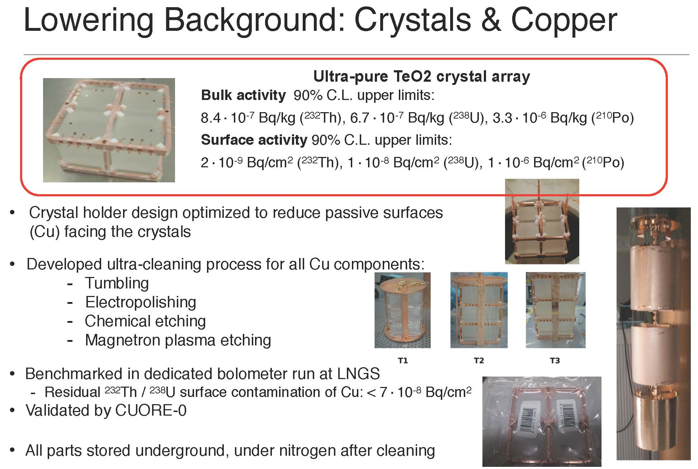

Slide 23
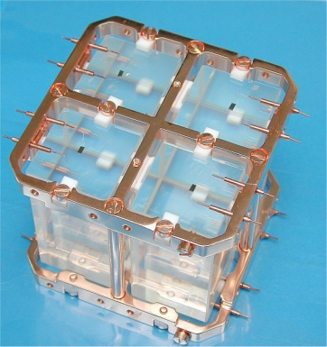
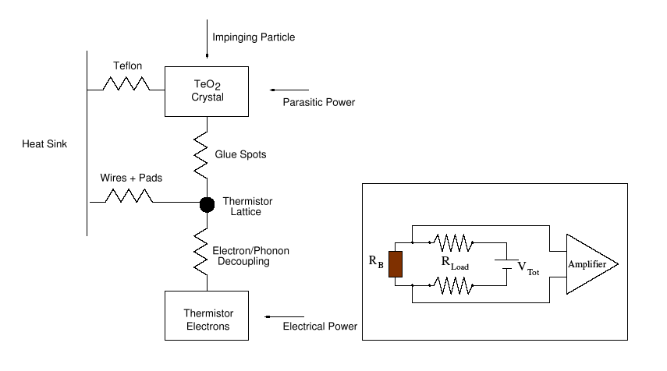
Bolometer
TeO₂ Bolometer: Source = Detector
Heat sink: ~8-10 mK
Thermal coupling: Teflon
Thermometer: NTD Ge thermistor
Absorber: TeO₂ crystal

Slide 24
Signal from NTD Ge Thermistor

Slide 25
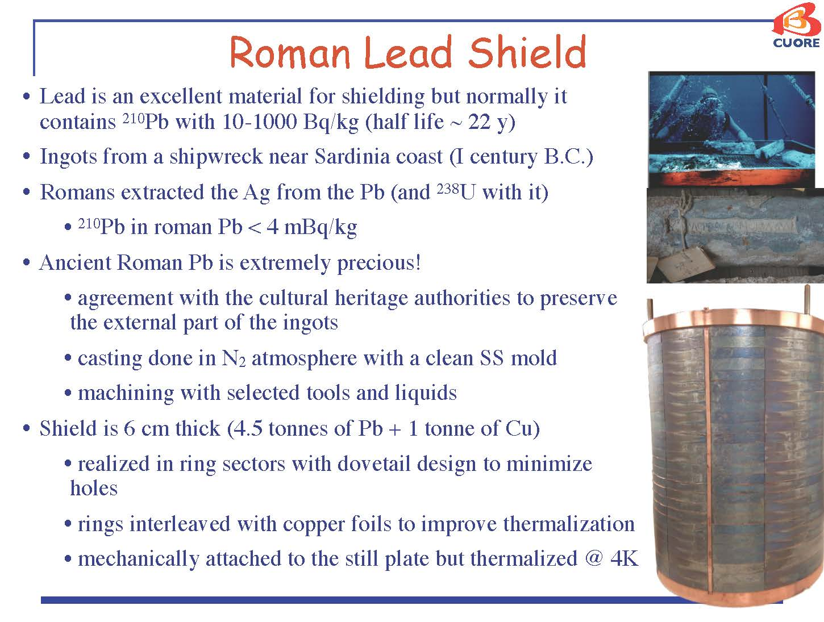

Slide 26
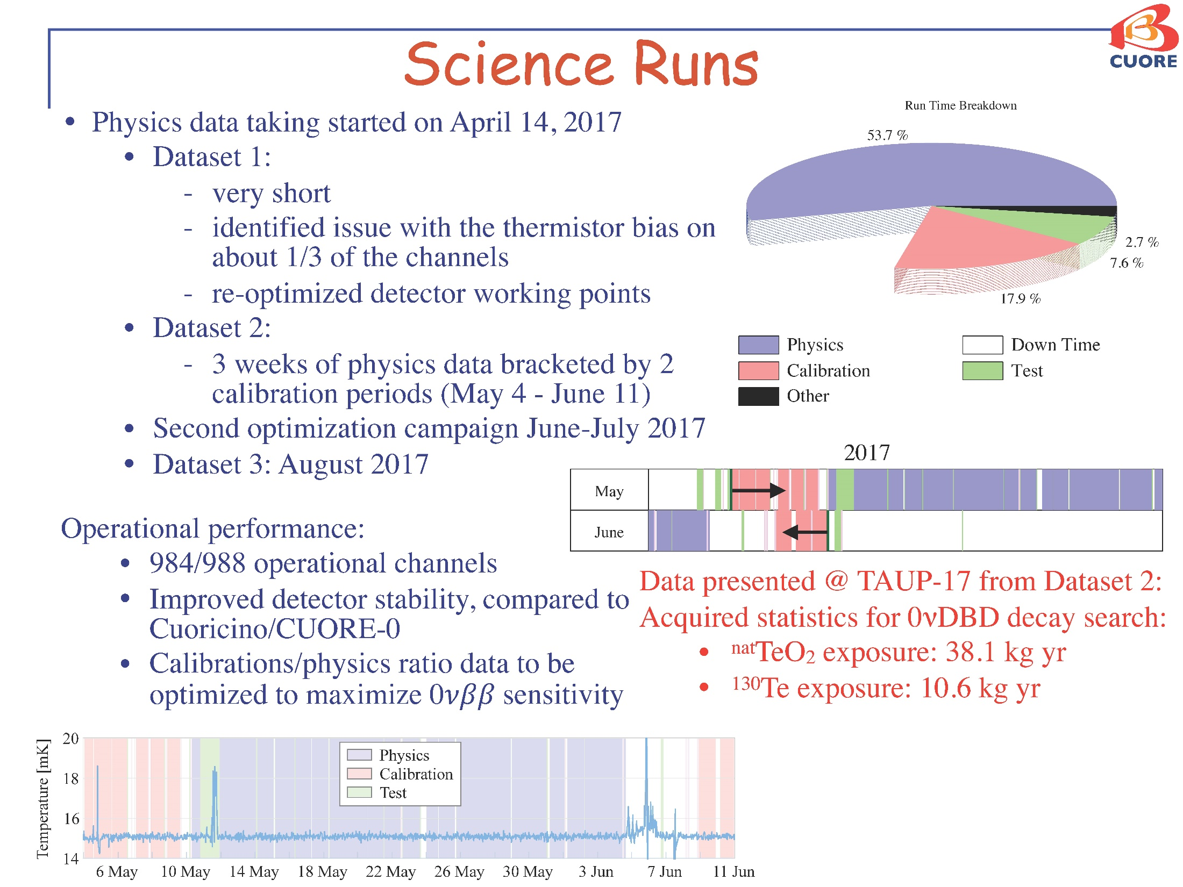

Slide 27
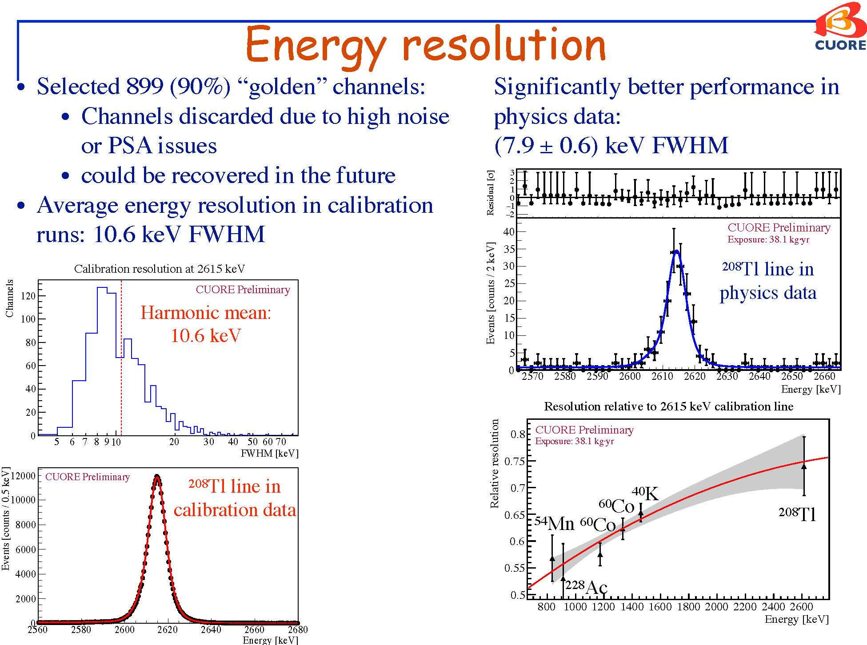

Slide 28
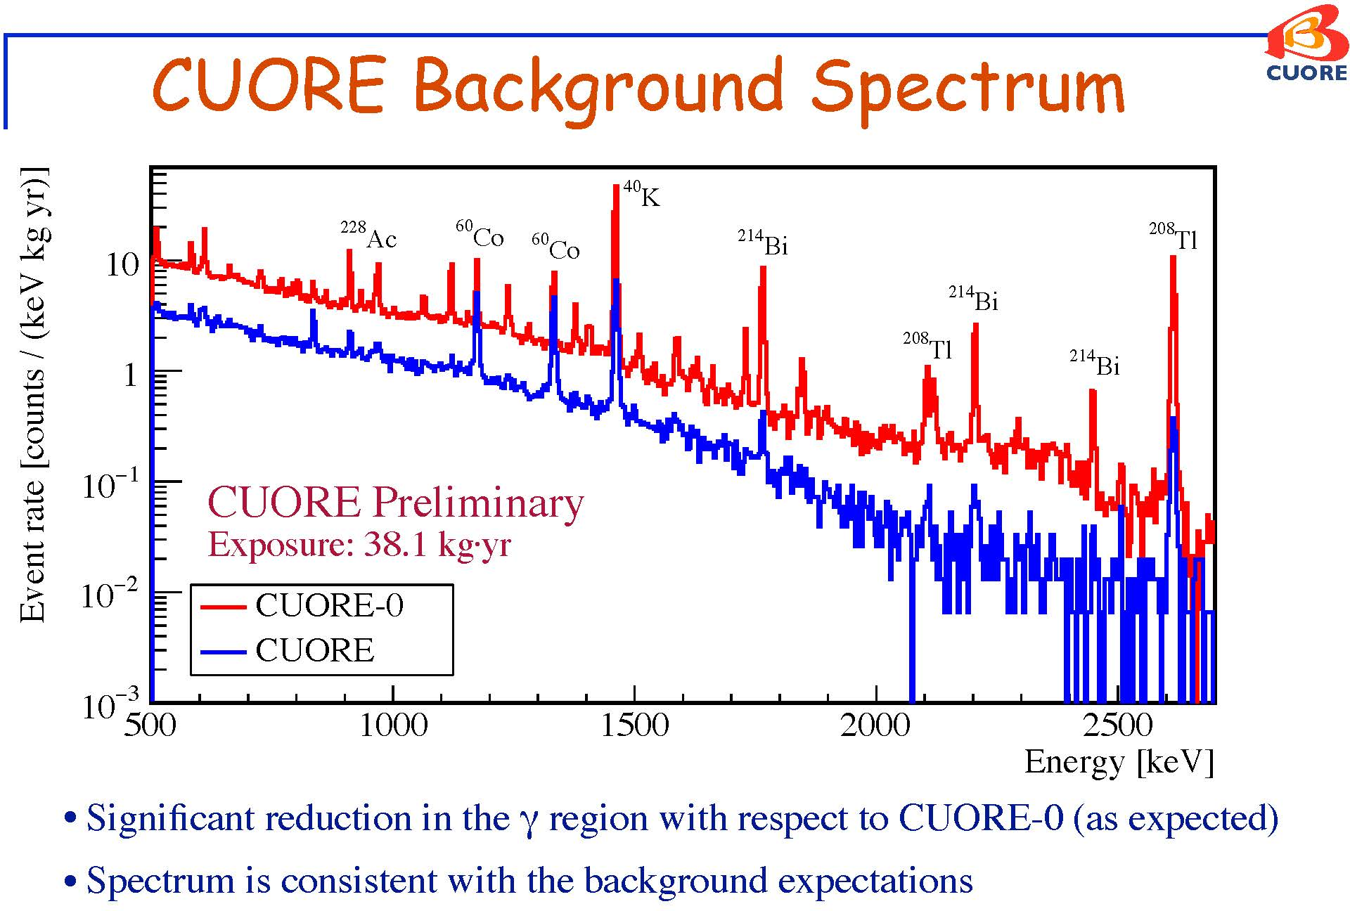

Slide 29
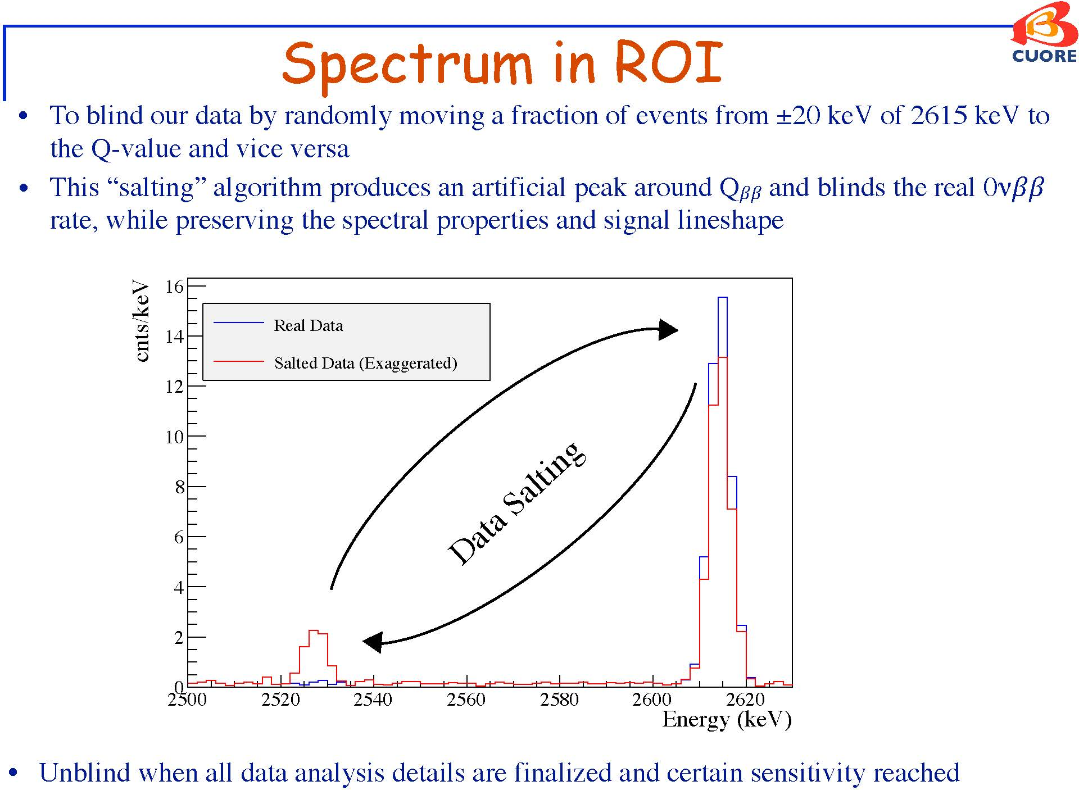

Slide 30
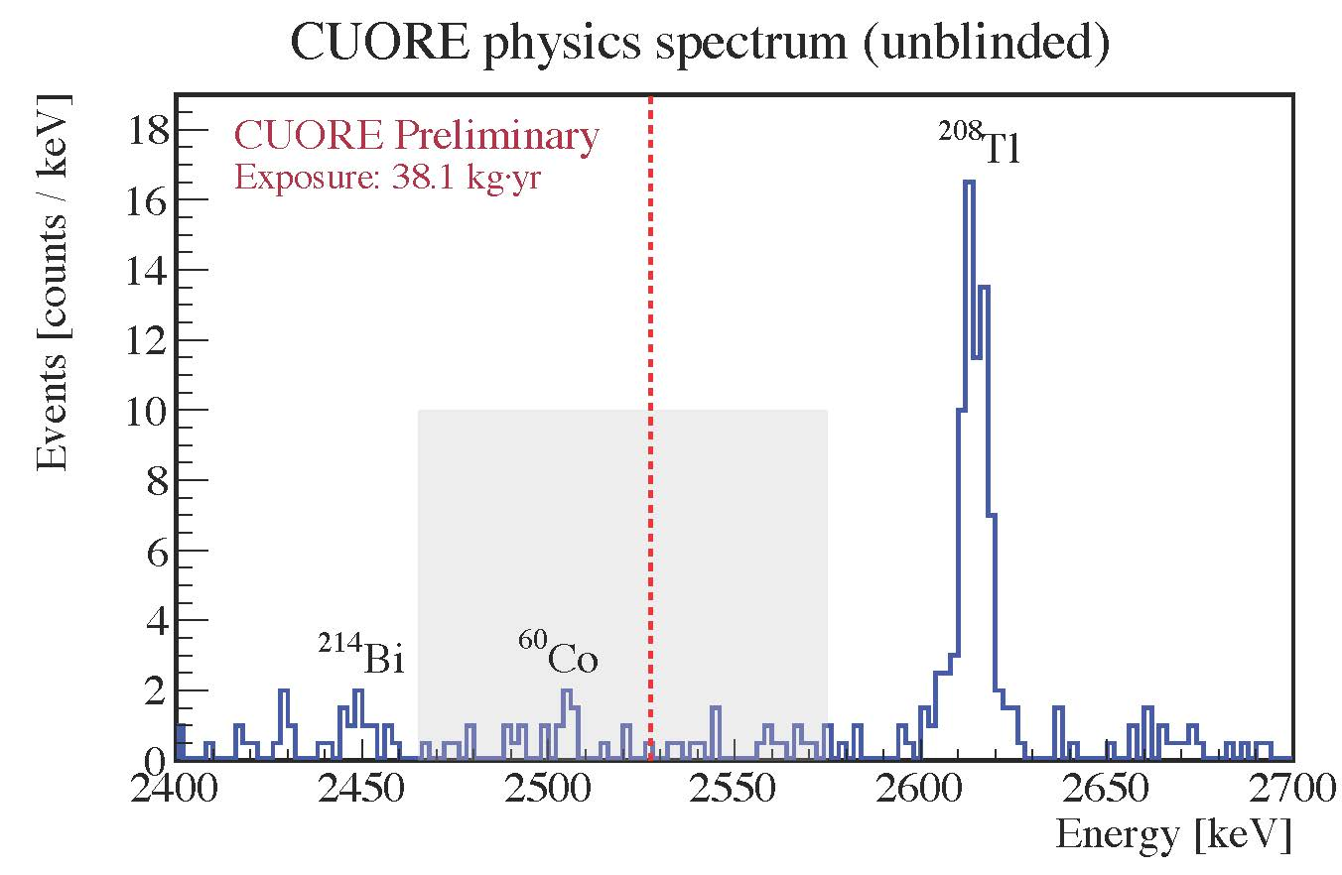

Slide 31
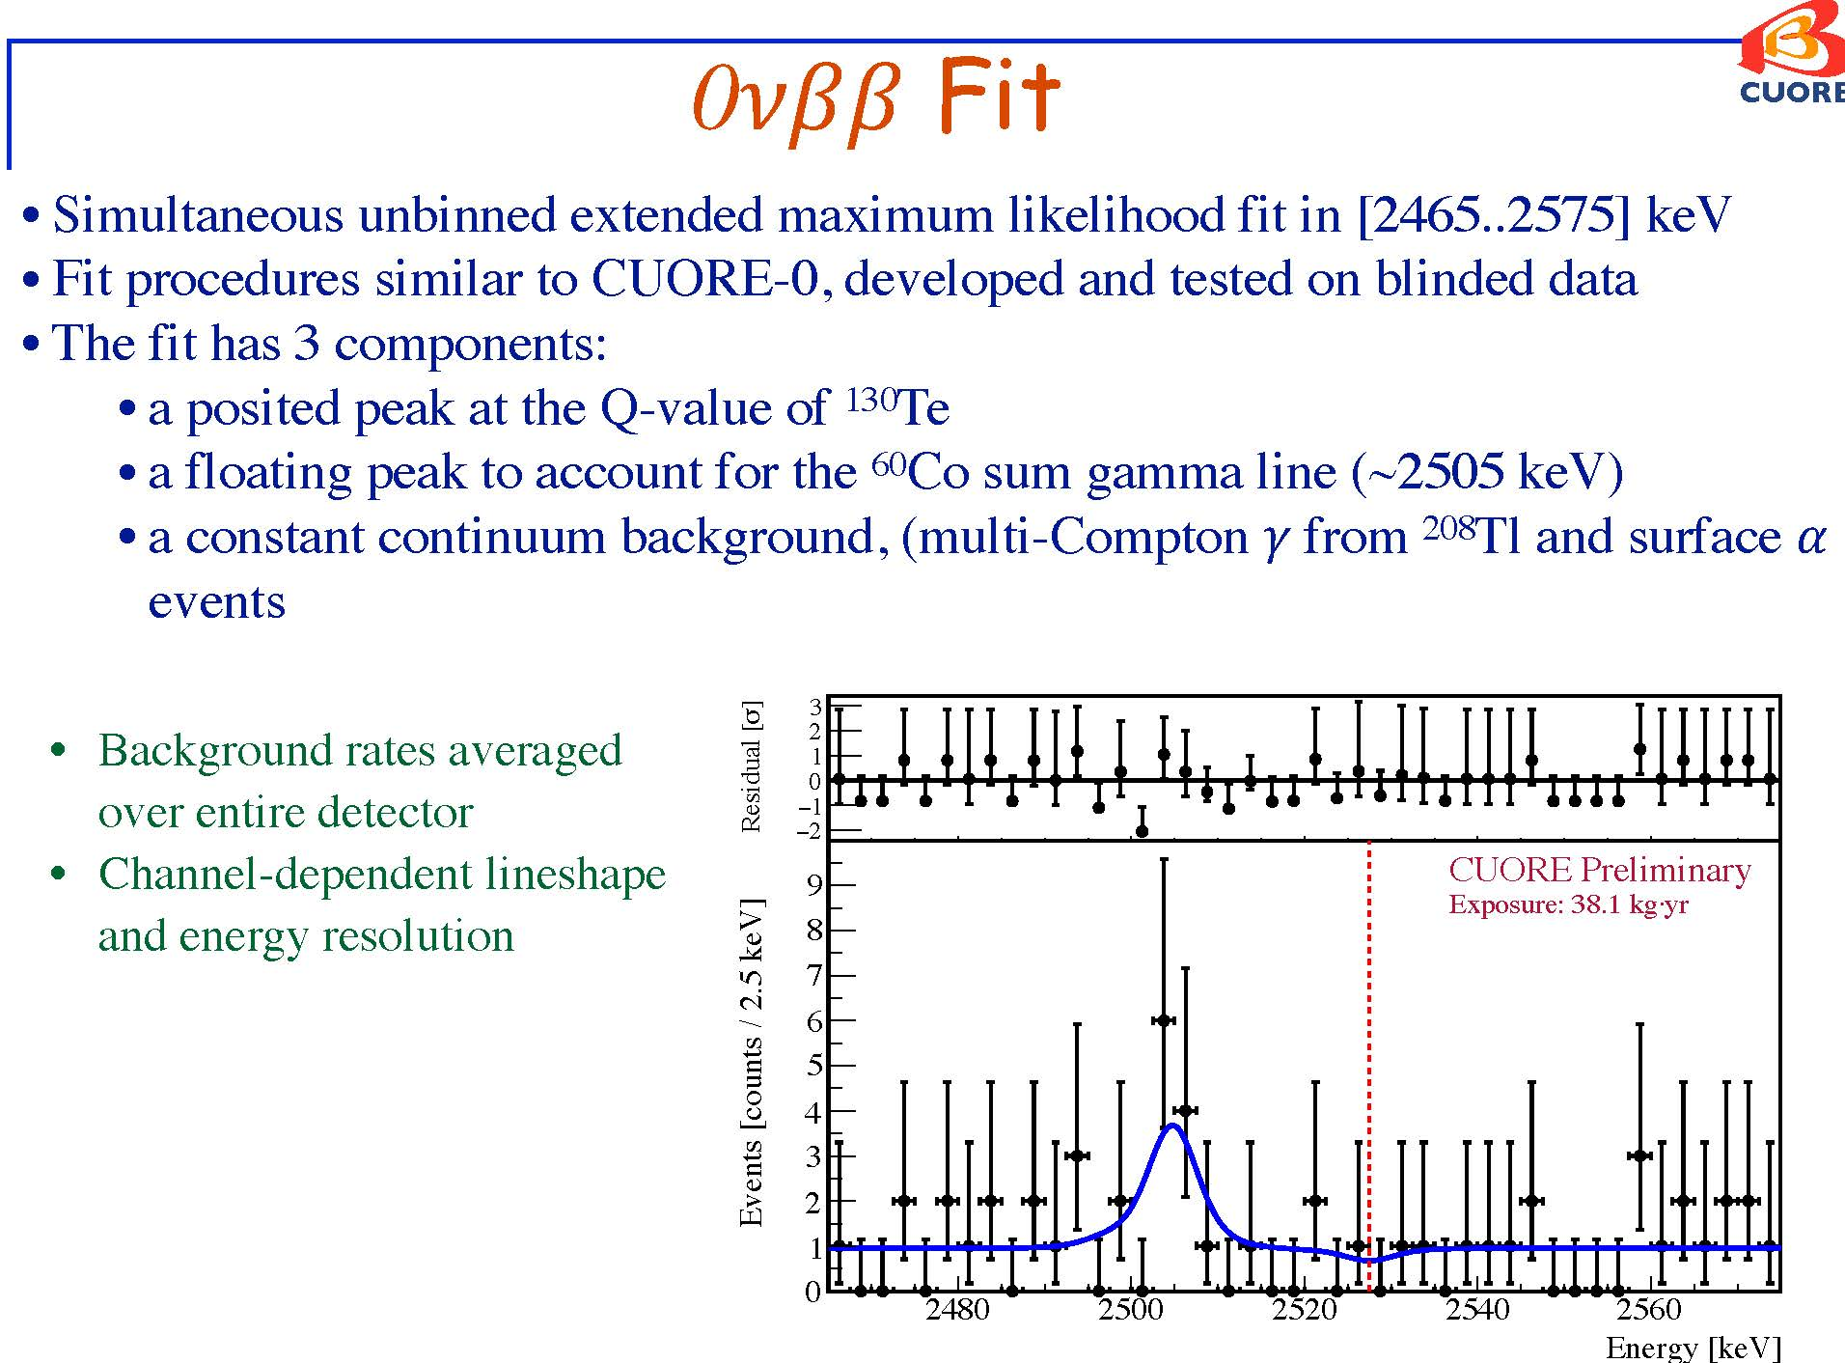

Slide 32
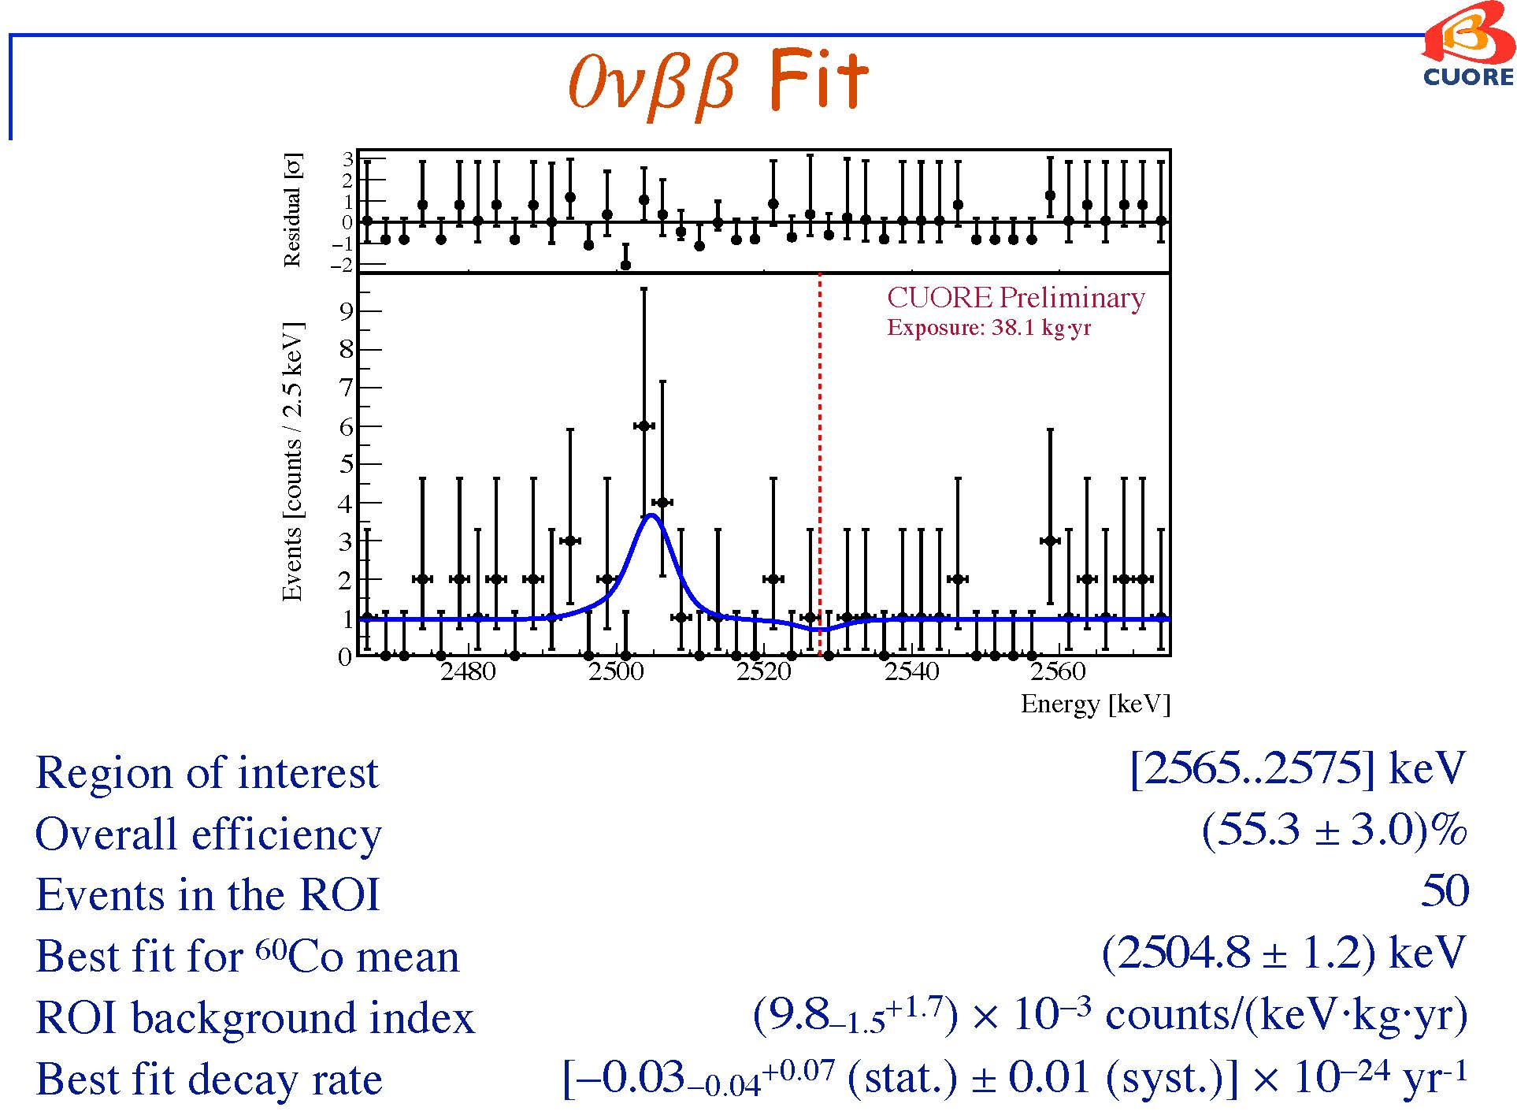

Slide 33
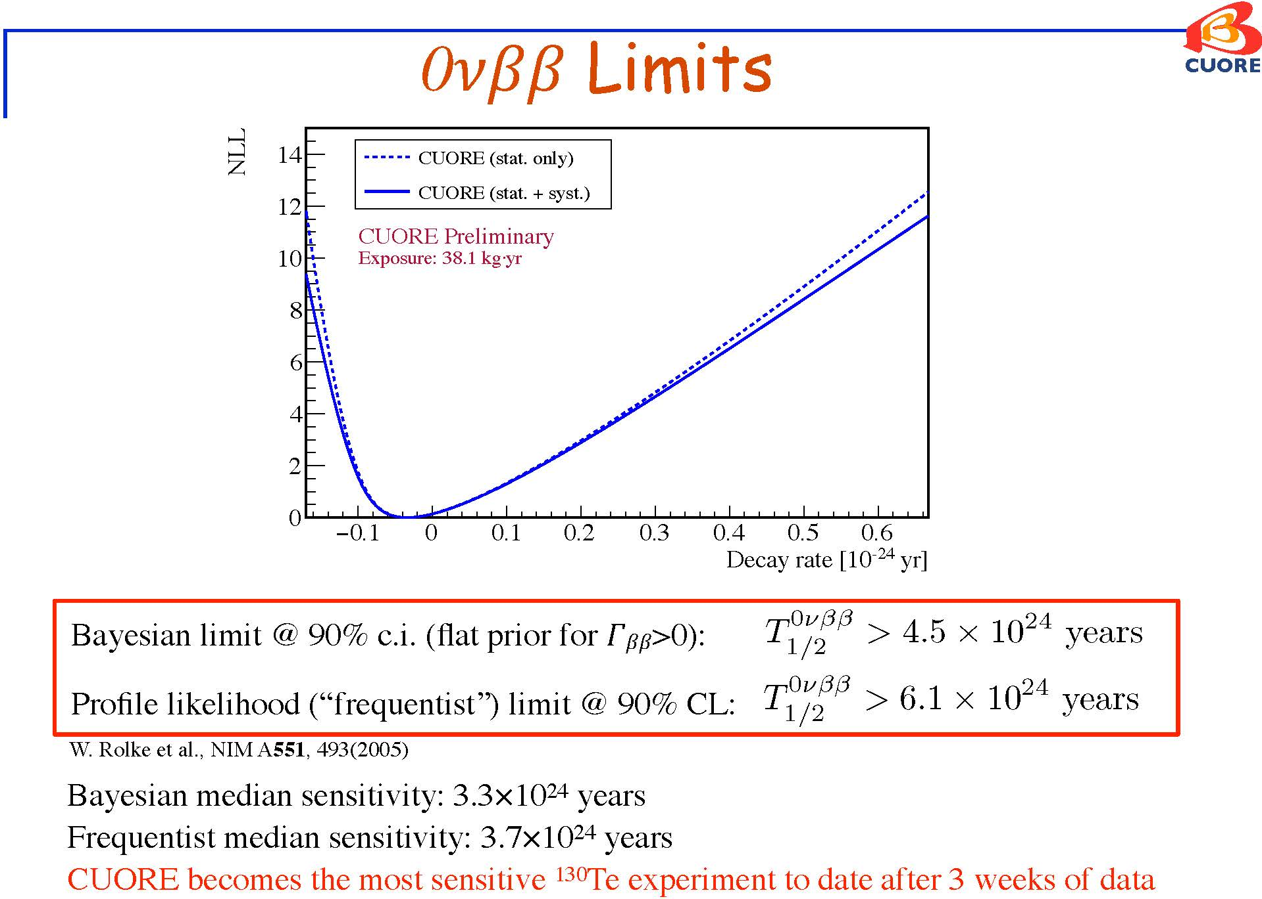

Slide 34
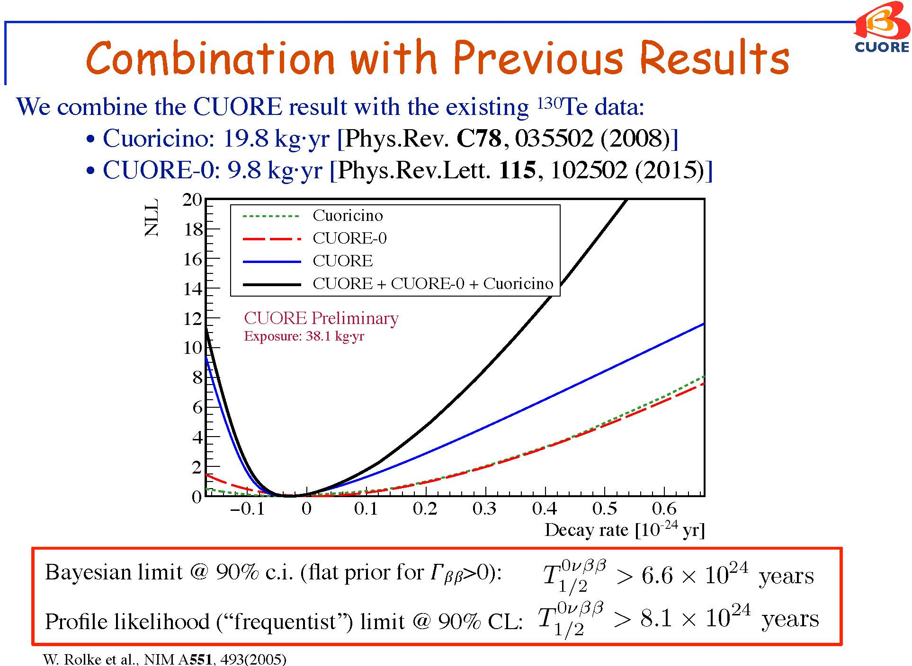

Slide 35
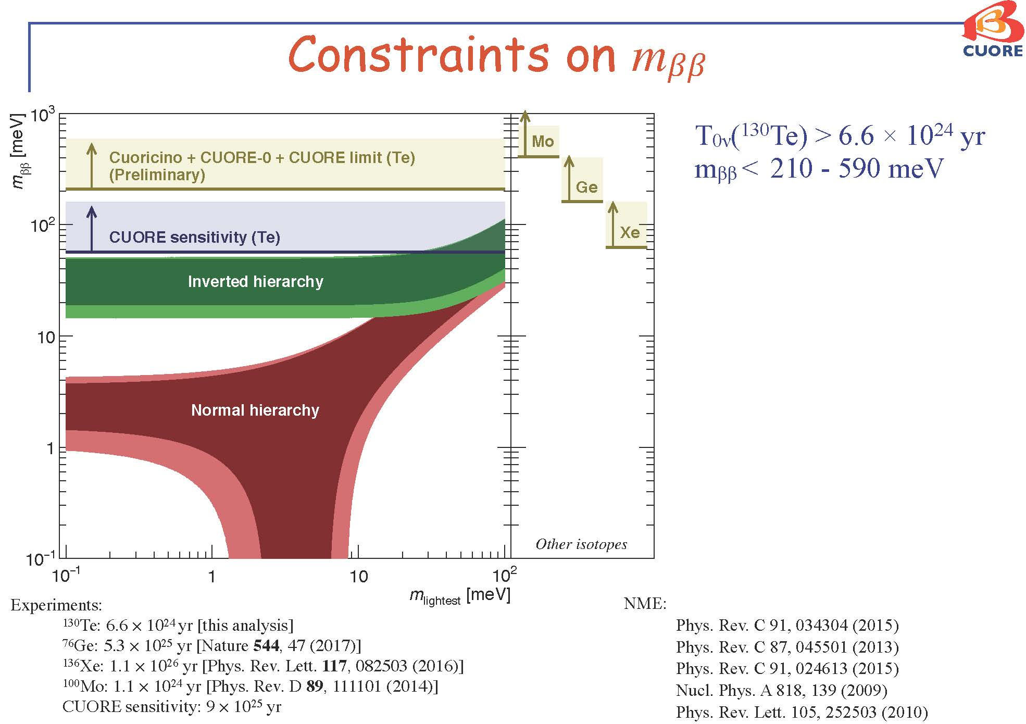
Need another factor of 10
to fully cover the IH region !

Slide 36
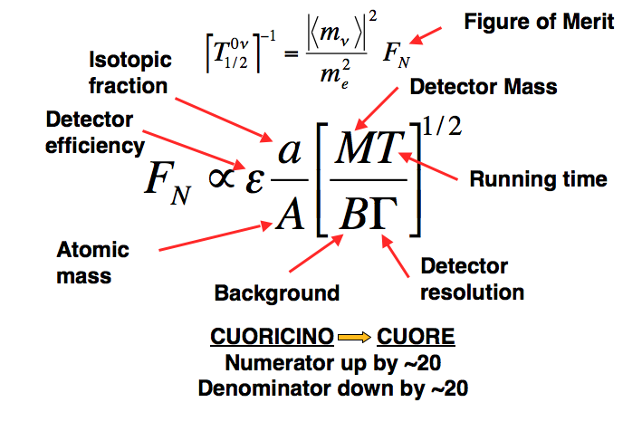

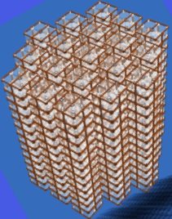
Scaling CUORE and Beyond

Slide 37
Future Path
Isotope Enrichment/Detector Mass -- Ton Scale
Te – less expensive, Q = 2528 keV < 2615 keV
Se, Mo and Cd – expensive
Q > 2615 keV
Background Reduction
degraded alpha
gamma – 2615 keV
Particle/Surface Identification from
pulse shaping
scintillation/Cerenkov/phonons

Slide 38
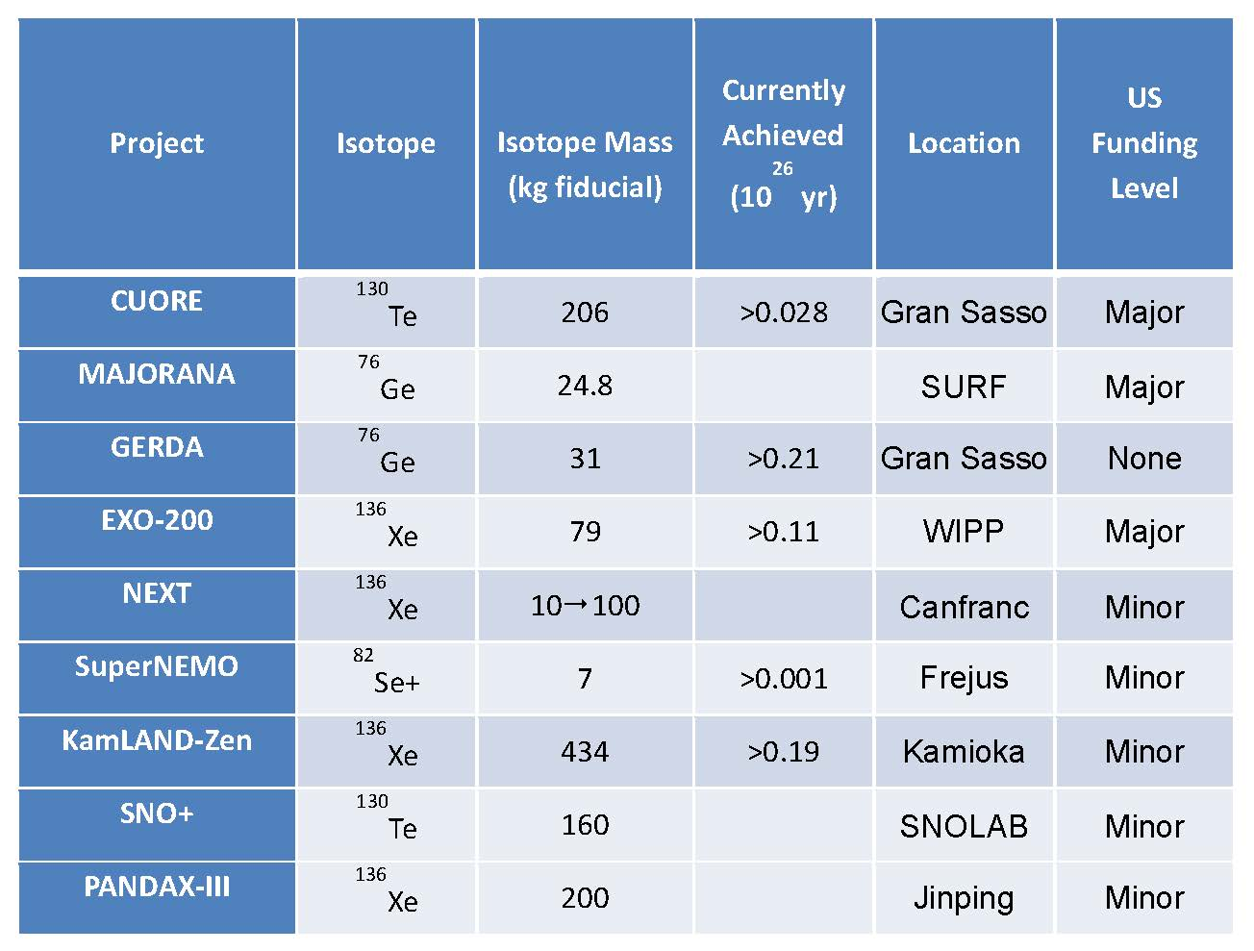
Status of 0νββ Experiments

Slide 39
Multiple Approaches Preferred
CUORE-- ¹³⁰Te
-- Excellent Energy Resolution (FWHM 0.2%)
-- Cost Effective
-- Particle ID Technique for Background Reduction
GERDA/MAJORANA -- ⁷⁶Ge
-- Ultra-Low Background Possible
-- Detector Segmentation and Pulse Shape
Analysis Possible
-- Very Costly !
EXO/HPXe -- ¹³⁶Xe
-- Easy to Scale Up
-- Ba⁺ Tagging Challenging / FWHM ~1%
-- Tracking Could Be Powerful
Measure different isotopes to establish 0vbb process !

Slide 40
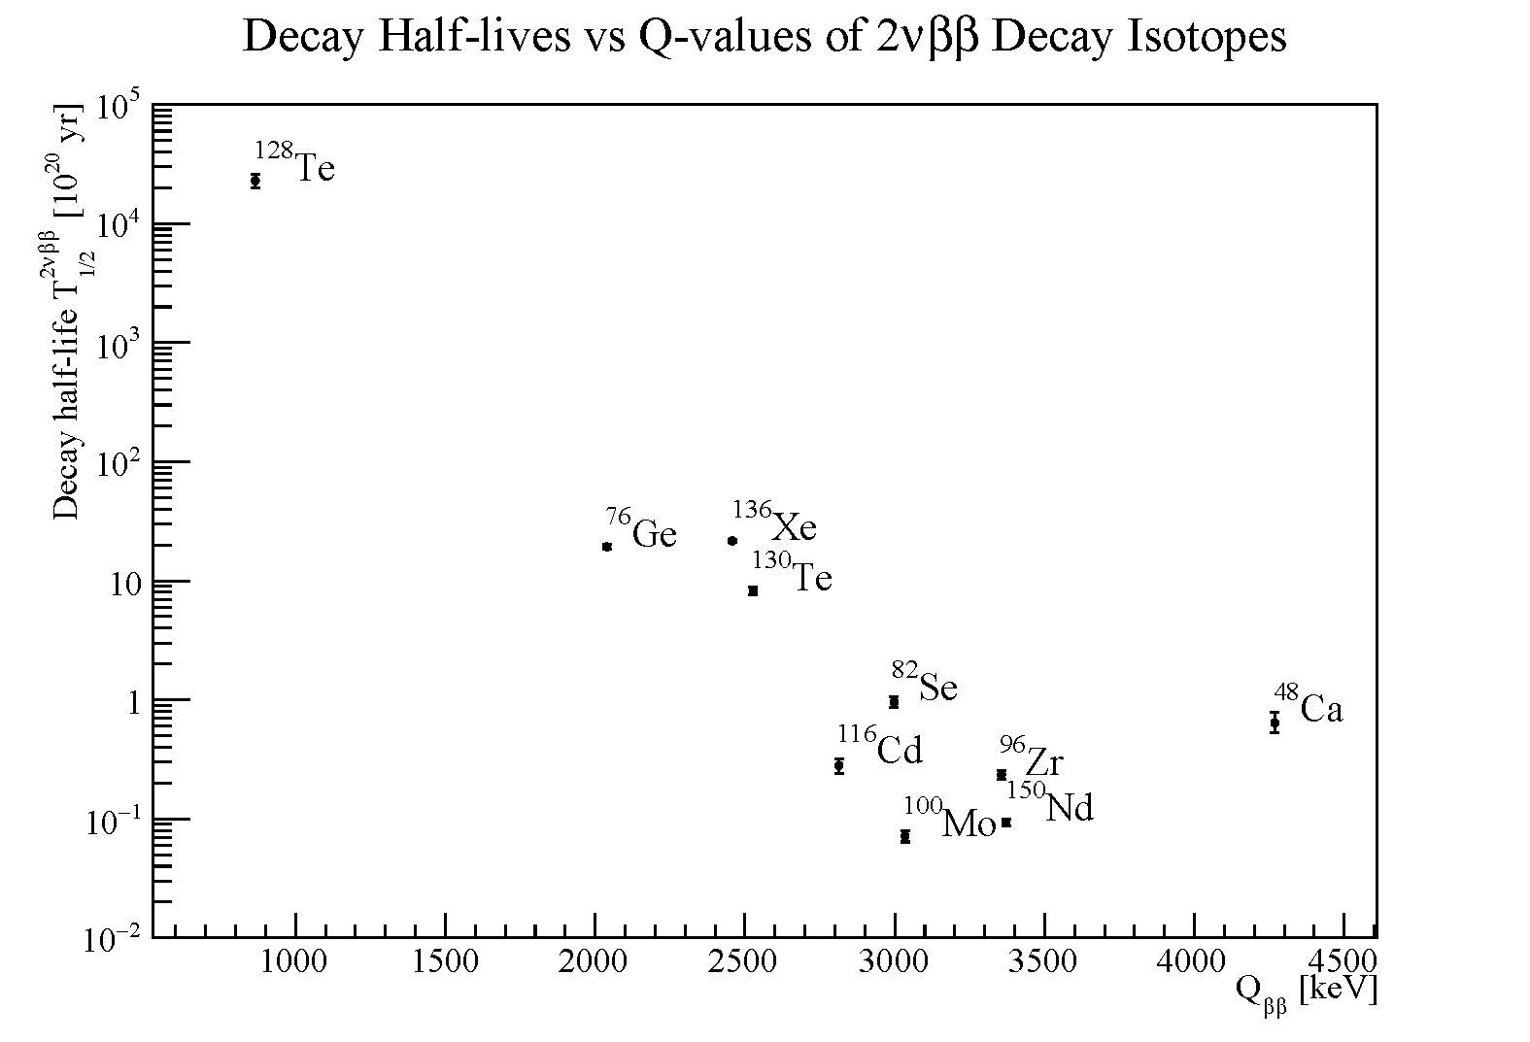
Comments on Isotopes
Enrichment Challenges
Te ¹²⁸Te -- 31.7%
¹³⁰Te – 34.1%
Xe ¹³⁴Xe – 10.4%
¹³⁶Xe – 8.9%
Mo ⁹⁸Mo – 24.3%
¹⁰⁰Mo – 9.7%
Se ⁸⁰Se -- 49.8%
⁸²Se – 8.8%
Ge ⁷⁴Ge -- 36.5%
⁷⁶Ge – 7.8%
Te, Xe and Mo relatively less expensive to enrich
Bolometer technology can work with Te/Mo well

Slide 41
Future Perspective
Neutrinos can lead to new frontiers
Neutrinos and the New Paradigm
-- neutrino masses, Dirac/Majorana and CP violation
FAR beyond the Standard Model
2) Neutrinos and the Unexpected
-- Many discoveries in recent years, what surprises and
extraordinary properties ahead?
3) Neutrinos and Cosmos
-- # of neutrinos, neutrino masses – large structures
CP violation – matter/anti-matter asymmetry
Recent technology development → verge of next
generation of 0vbb experiment
A unique opportunity for Chinese Nuclear Physics

Slide 42
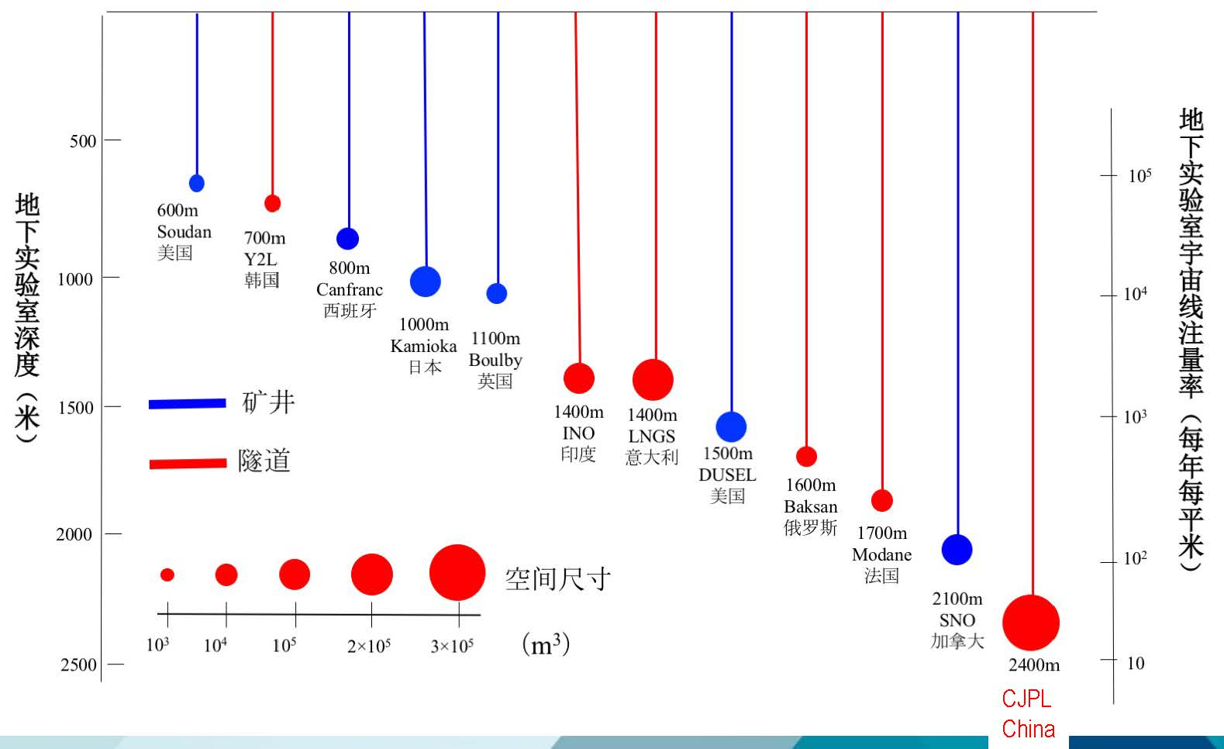
Best Underground Laboratory in the World !

Slide 43
CUPID-China Collaboration
CUPID – CUORE Upgrade with Particle IDentification
---- Develop Low Temperature Bolometer Technology
for next generation of 0vbb experiment with
> 1 ton effective 0vbb isotope
International Collaboration:
CUPID – Italy
CUPID – US
CUPID – France
CUPID – China
复旦，上海应用物理研究所，上海硅酸盐研究所，
上海交大，中国科大，宁波大学，清华，北京师大
@中国锦屏地下实验室（CJPL）
3-5 年 – 掌握和研发最先进低温晶体量热器技术，达到
新一代吨级探测器的本底要求 1c/keV/ton/year
5-10年 – 建造和运行新一代0vbb探测器 (TeO₂和Li₂MoO₄)
Support and/or Join CUPID-China Project !!

Slide 44
The END

Slide 45


CUORE Collaboration

Slide 46
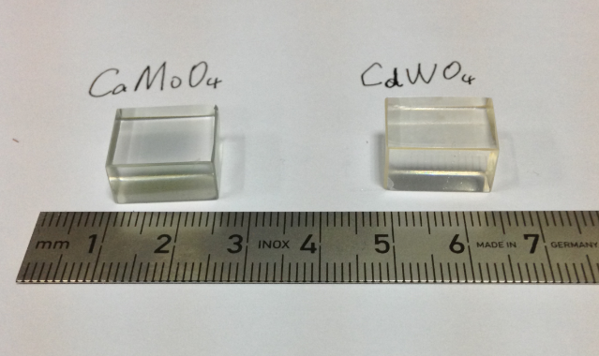
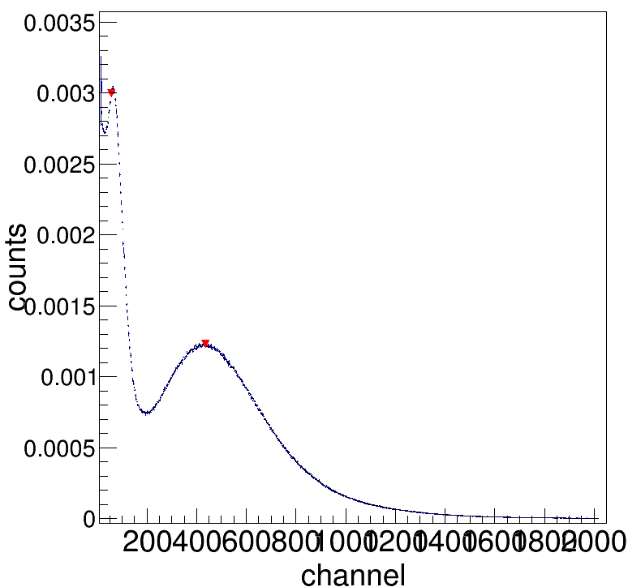
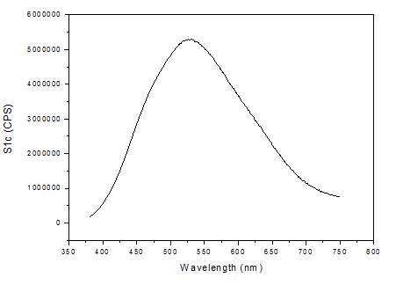
USTC Crystal R&D
spe
Photon-electron peak of 59keV Υ-rays from ²⁴¹Am
Emission Spectrum
CaMoO₄: 51ph.e/MeV
Next Step ZnMoO₄ ?

Slide 48
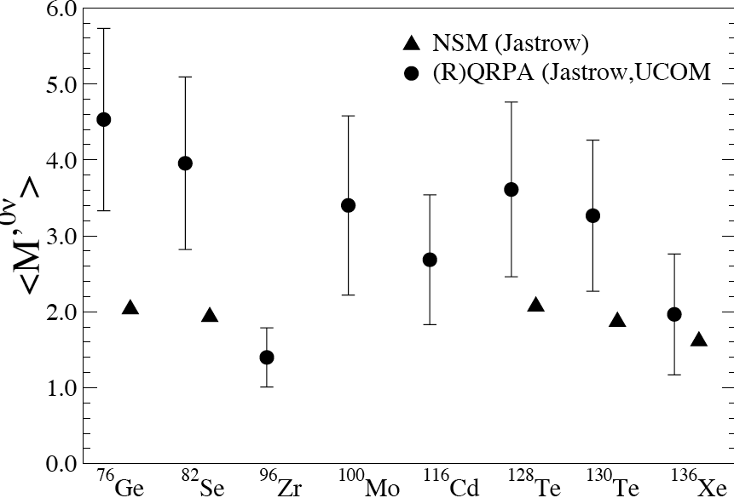
Full estimated range of M^{0ν} within QRPA framework and comparison with NSM
(higher order currents now included in NSM) – P. Vogel

Slide 49
Possible Short Path to the Front
Chinese 0vbb Program –
1) Mature technology -- bolometer
2) Technology – Crystal growth
3) Reasonable chance to succeed
Need R&D Effort
Isotope enrichment /crystal /QA
cryogenic technology
read-out
Shielding and Radon
Cu – underground production
Material Selection

Slide 50
Majorana Particles
Helicity
H = -1
H = +1
p
p
spin
For massless particles, neutrino => H eigenstate
neutrino with masses ➔ H not exact quantum #
Dirac Particles ➔ particle and anti-particle different
-- electron (q=-1) and positron (q = +1)
-- quarks (q) and anti-quarks (-q)
Majorana Particles ➔ particle and anti-particle same
-- neutral particle, fermion
-- beyond Standard Model (lepton # violation)

Slide 51
